Slide 1
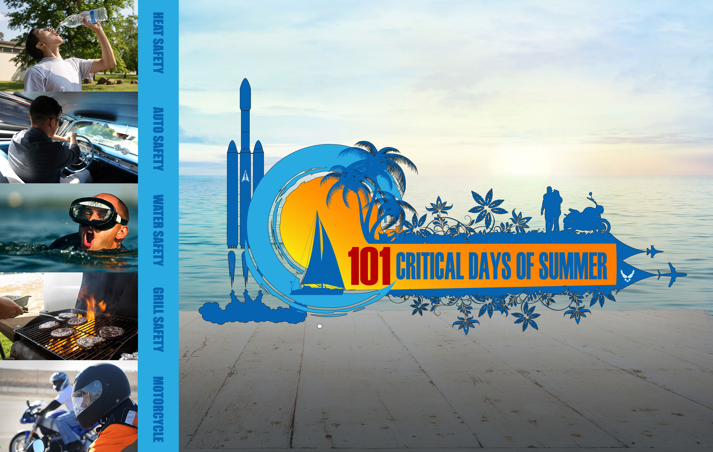

2024

Slide 2

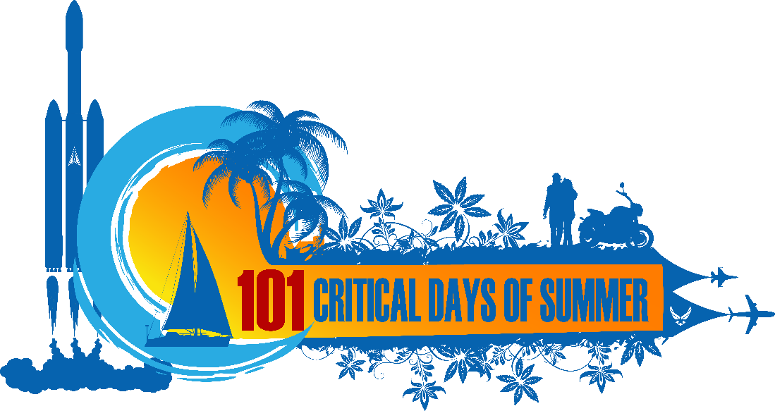
SUMMER SAFETY MENU
Introduction 3
Last Summer Fatalities 4
Risk Management 5
Water-Related Activities 6
Adult Swimming Safety 7-8
Pool Chemical Safety 9-10
Boating Safety 11-14
Diving Safety 15
Alcohol Safety 16
Afloat Drinking 17
Mixing Sun and Alcohol 18
Boaters’ Hypnosis 19
Heat and Sun Safety 20
Heat-Related Illness 21
Heat Safety Tips 22-23
Sun Safety 24-25
Fireworks Safety 26
General Fireworks Rules 27
Sports-Related Activities 28
Sports Injury Prevention 29
Cardio Activities 30-33
Firearms Safety 34
Handling Firearms 35-36
Driving Safety 37
Safe Driving 38
Driving Fatalities 39
Drinking and Driving 40
Drowsy Driving 41
Distracted Driving 42
ATV and UTV Safety 43
Motorcycle Safety 44
Motorcycle Riding Safety 45
Motorcycle Safety Tips 46
Motorcycle PPE 47
Pedestrian Safety 48
Pedestrian Safety 49
Home Safety 50
Slips, Trips and Falls 51
Grilling Safety 52
Open Fire Safety 53
Gardening Safety 54-55
Bladed Tool Safety 56-57
Mishap Reporting Reminder 58
Conclusion 59
Safety Links/QR Codes 60
2024
02

Slide 3

INTRODUCTION
MANAGING YOUR RISK
Summer is nearly here so it's time to think about the 101 Critical Days of Summer safety. Historically, it is the largest vacation period of the year for military members, beginning with Memorial Day weekend and ending with Labor Day weekend. The summer months are filled with warm weather, celebrations and longer days. Driving and traveling increase exponentially. The 101 Critical Days of Summer also includes three holidays, which are normally approved for long weekends.
During these longer days, potential lapses in judgment while engaging in summer activities can impact the readiness of Airmen and Guardians. A general lack of situational awareness and complacency are root causes in numerous off-duty mishaps from last summer.
The following presentation provides general summer safety information to help you – and your team – maintain an active risk management mindset to ensure an enjoyable and safe summer.
Click here to return to the
SUMMER SAFETY MENU
03

Slide 4
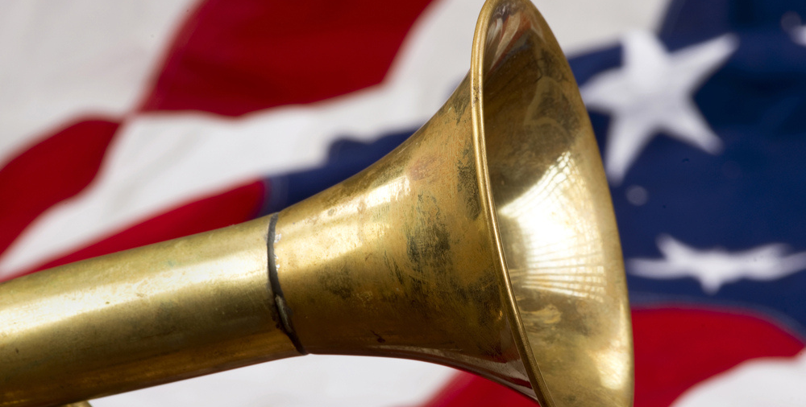
LAST SUMMER FATALITIES
ONE OFF-DUTY DEATH IS ONE TOO MANY
During the Summer season in 2023, the Department of the Air Force lost 19 Airmen and Guardians to preventable off-duty mishaps. Motor vehicle, motorcycle and off-road vehicle mishaps were the leading causes.
Operating/Occupant Motor Vehicle (15)
Incidental/Routine Activities (3)
Outdoor Activities (1)
Click here to return to the
SUMMER SAFETY MENU
04

Slide 5
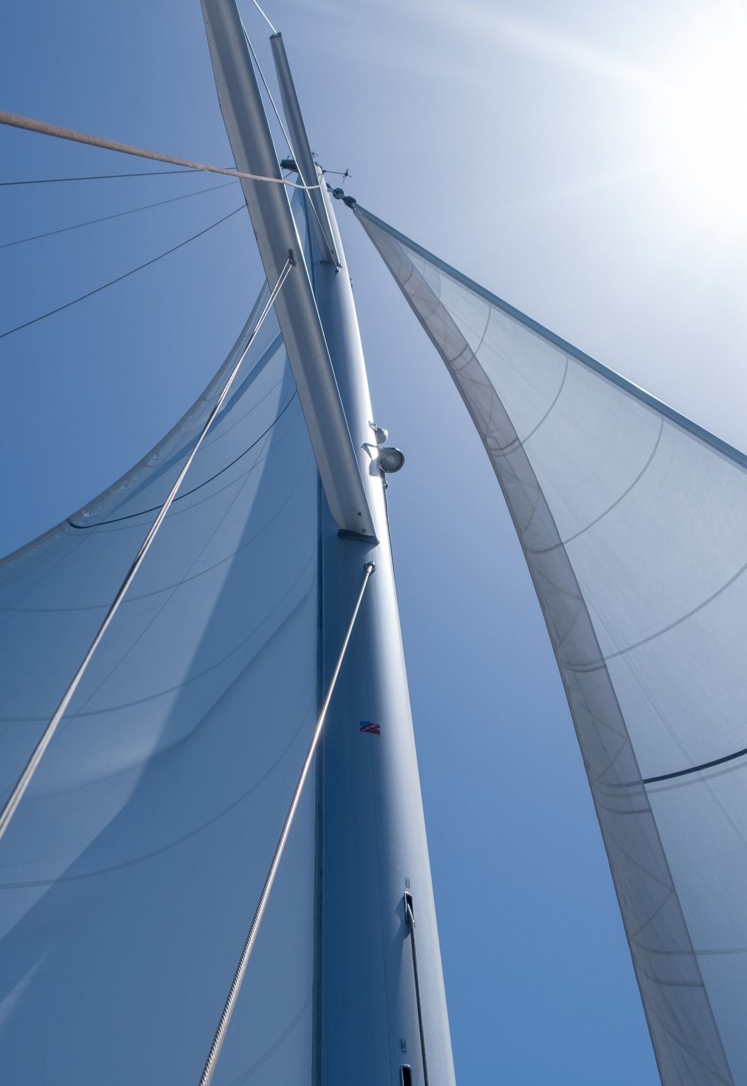
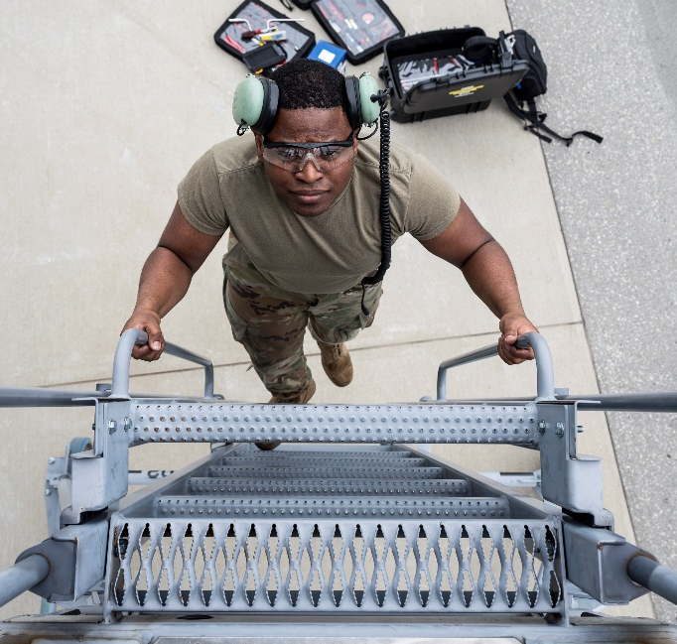
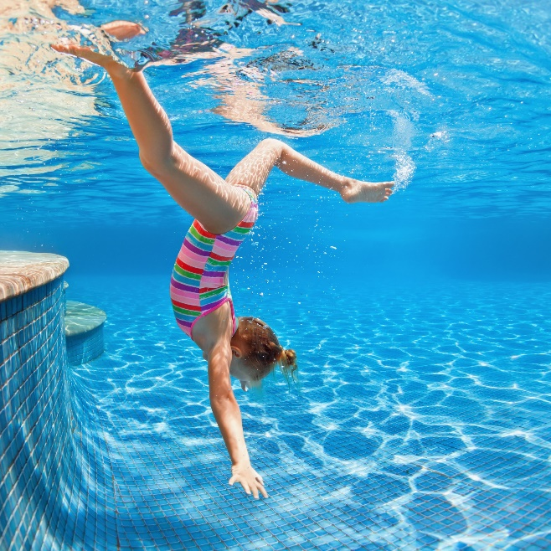
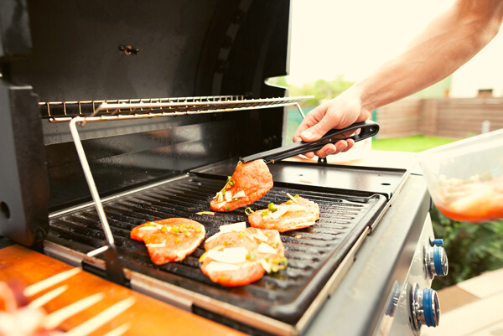
RISK MANAGEMENT
The Department of the Air Force ‘s Risk Management program empowers our people to self-assess and self-correct risk, from the tarmac to senior leaders, both on and off duty. An active risk management mindset in defending the Human Weapon System– whether at work, on the flightline or grilling on your back porch – contributes to readiness.
Every member of our forces must adopt a learning mindset and commit to working collaboratively to educate, inform and hold each other accountable for decisions we make both on and off duty.
The majority of off-duty recreational mishaps are entirely preventable and avoidable, provided service members perform risk assessments and comply with laws, procedures and recommended best practices for a given activity.
04
Click here to return to the
SUMMER SAFETY MENU
05

Slide 6
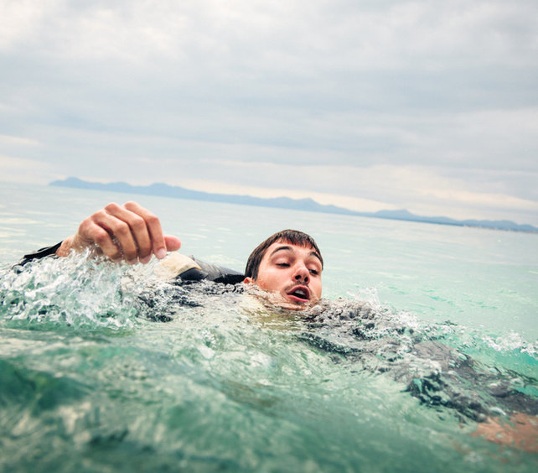

WATER-RELATED ACTIVITIES
The Department of the Air Force noted a 44% decrease in water-related injuries from 2013-2023. According to National Safety Council statistics from 1999-2022, an average of 533 people drown per month between May and September in the U.S.
Click here to return to the
SUMMER SAFETY MENU
06

Slide 7
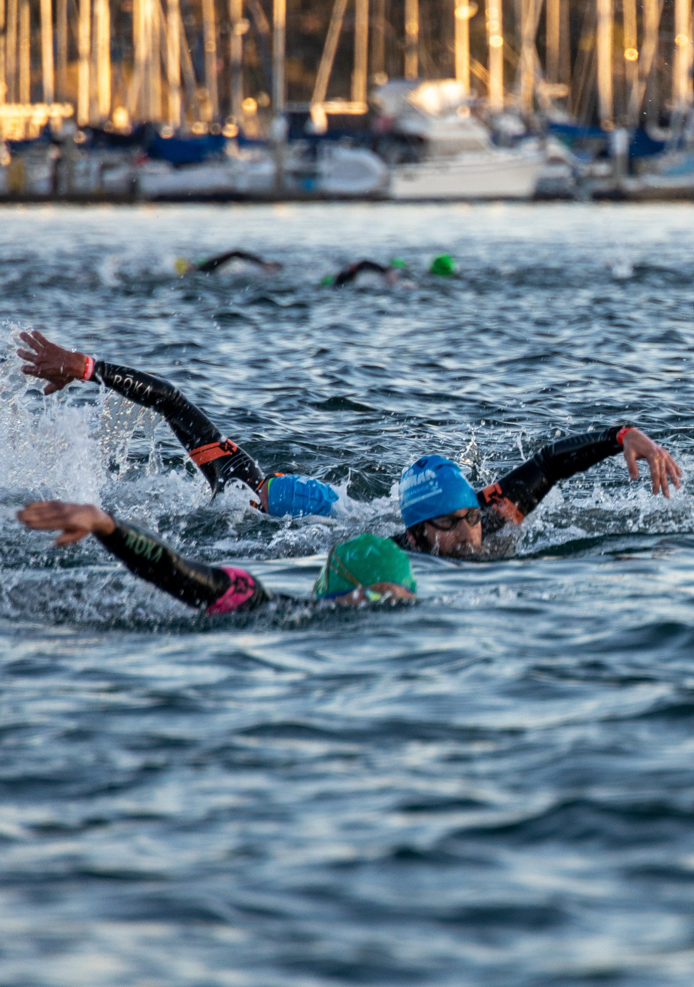
ADULT SWIMMING SAFETY
MAINTAIN SELF-AWARENESS OF SWIMMING SKILLS
  Don't swim alone. Always swim with a partner.
  Never swim under the influence of alcohol, drugs or medication.
  Know and observe your swimming limitations and capabilities.
  Avoid swift-moving water. If caught in a current, swim with it and angle toward shore or the edge of the current. (Rip currents are powerful currents of water moving away from shore that can sweep even the strongest swimmer out to sea.)
  Stay out of the water during thunderstorms and severe weather.
  Don't get too tired, too cold, too far from safety, exposed to too much sun or experience too much strenuous activity.
Click here to return to the
SUMMER SAFETY MENU
07

Slide 8

ADULT SWIMMING SAFETY
CONTINUED
  Even if you’re a good swimmer, wear a U.S. Coast Guard-approved life jacket. The American Canoe Association estimates that almost 70% of drownings that involve canoes, kayaks and rafts could have been avoided if a personal flotation device (PFD) was worn.
  Label gear with contact info. Labeling gear with your name and two contact numbers could help the U.S. Coast Guard identify your equipment in the case of an emergency.
  The U.S. Coast Guard offers a nation-wide program called Operation Paddle Smart to encourage people to label their equipment. You can get a free, reflective waterproof sticker for your gear at local boating supply stores, canoe clubs and harbor masters.
  Have a way to call for help. Ensure cell phone is charged and in a waterproof case or take a two-way radio with you. For serious adventurers, consider purchasing a personal location beacon, outfitted with a flotation sleeve.
Click here to return to the
SUMMER SAFETY MENU
08

Slide 9
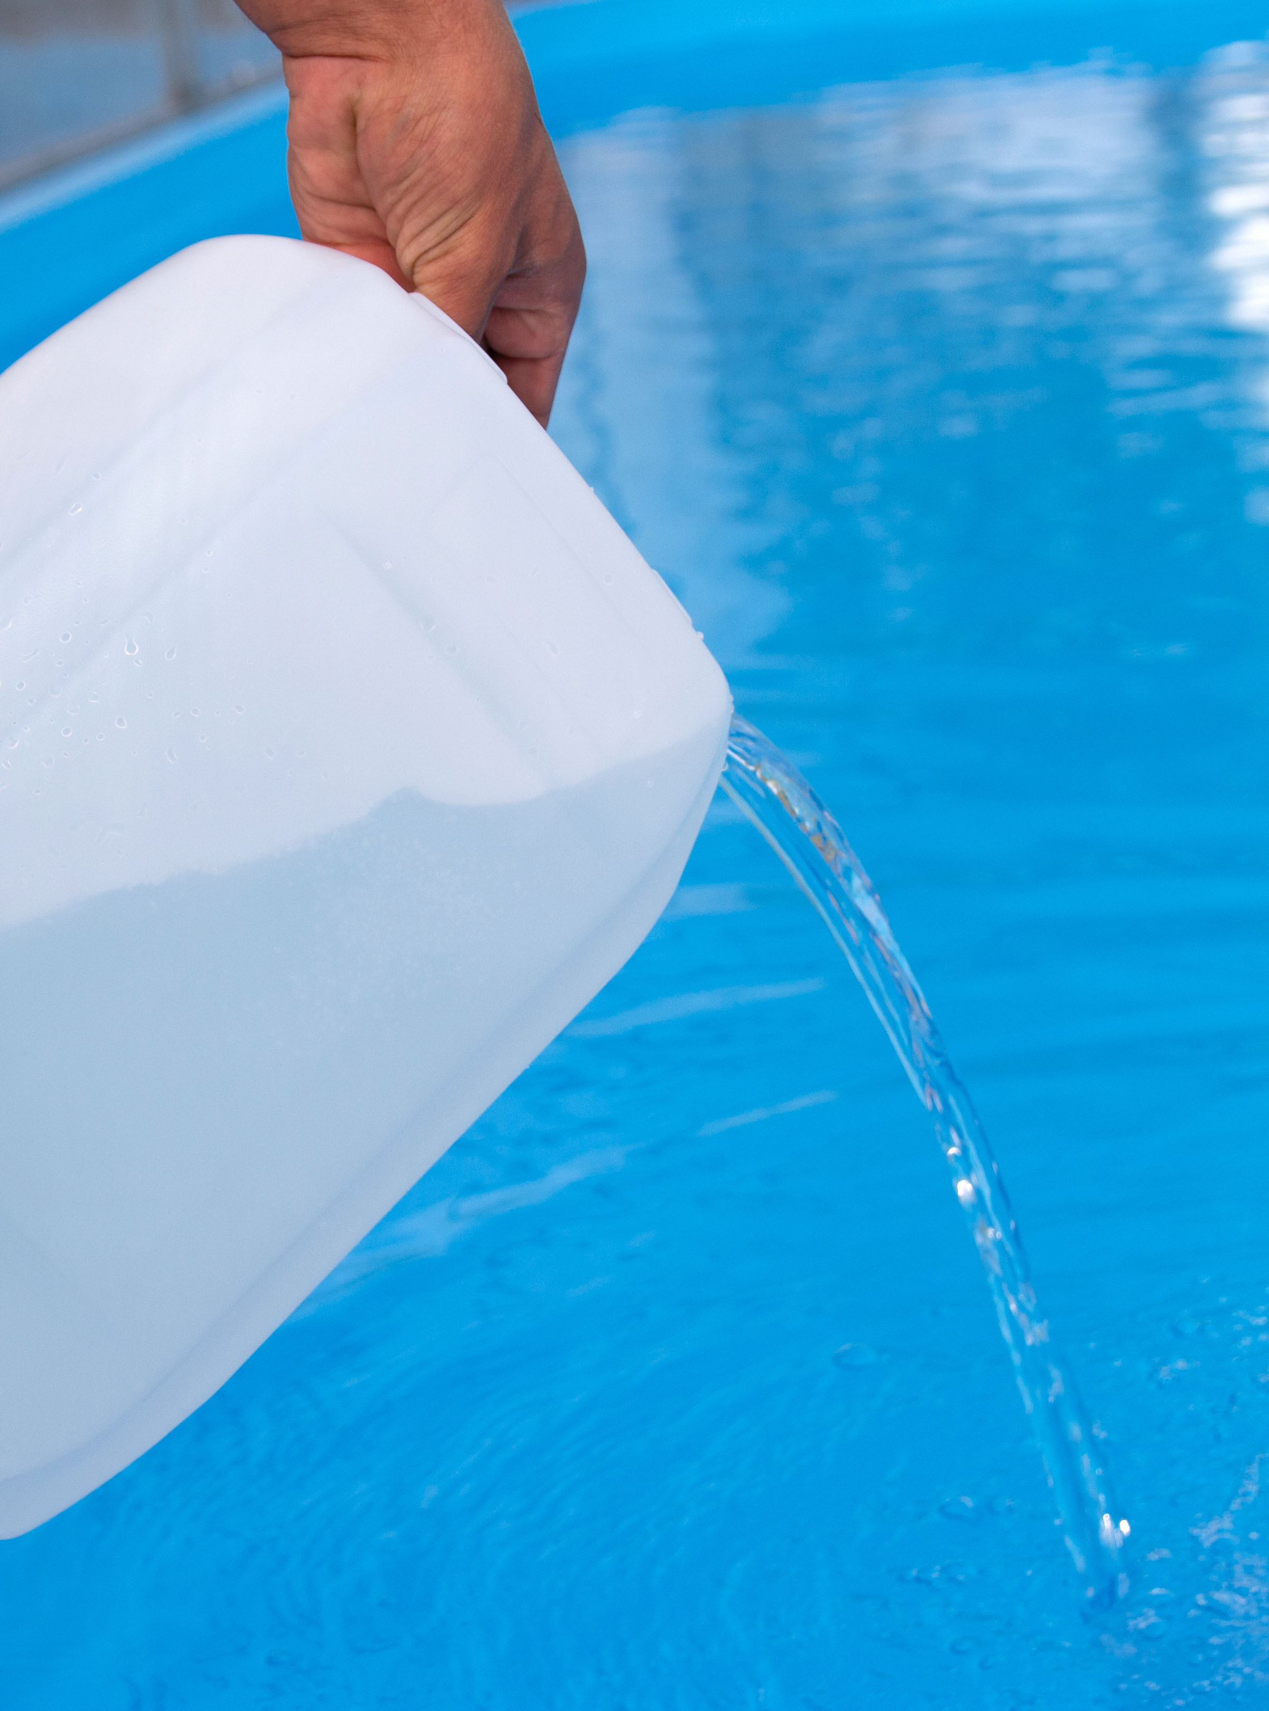
POOL CHEMICAL SAFETY
SAFE USE
  Ask for help if you are not trained for specific tasks.
  Read chemical and entire product labels or Material Safety Data Sheets before each use.
  Dress for safety by wearing appropriate safety equipment (i.e., safety goggles, gloves and mask).
  Handle in a well-ventilated area.
  Open one product container at a time and close it before opening another.
  Minimize dust, fumes and splashes.
  Measure carefully.
  Never mix chlorine products with acid; this could create toxic gases.
  Never mix different pool chemicals (i.e., different types of chlorine products) with each other or with any other substance.
  Only pre-dissolve pool chemicals when directed by product label.
  If product label directs pre-dissolving, add pool chemical to water; never add water to pool chemical because a violent, potentially explosive reaction can occur.
Click here to return to the
SUMMER SAFETY MENU
09

Slide 10
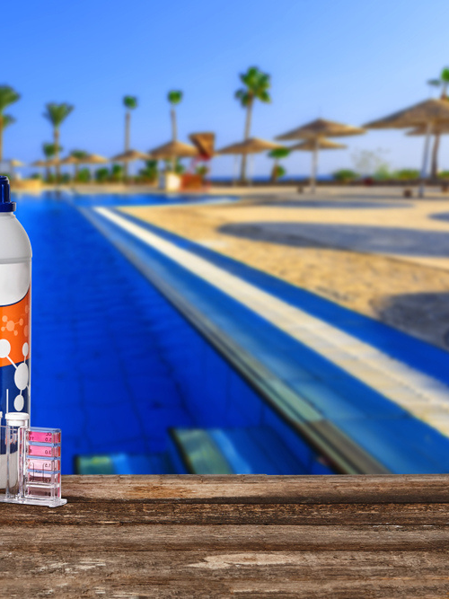
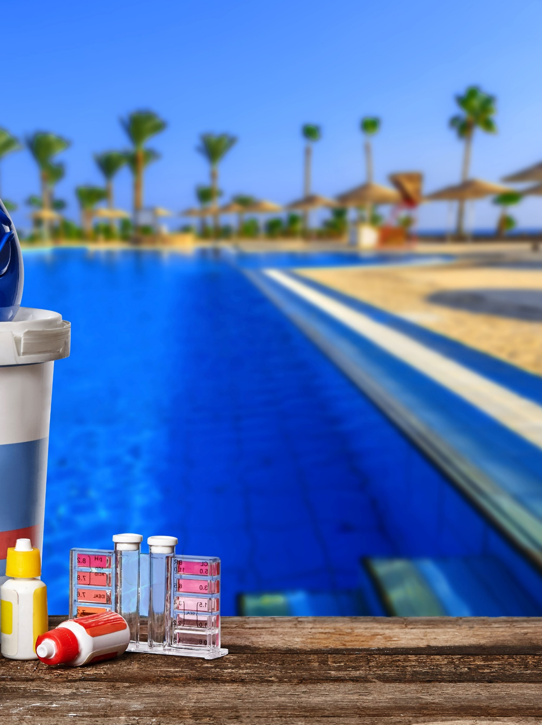
POOL CHEMICAL SAFETY
SAFE STORAGE AND DISPOSAL
STORAGE
  Follow product label directions for chemical storage.
  Wear appropriate safety equipment (i.e., safety goggles, masks and gloves).
  Separate incompatible chemicals (for example, acid and chlorine).
  Lock chemicals up to protect people and animals.
  Keep chemicals dry and don't mix different chemicals (i.e., different types of chlorine products).
  Keep chemicals cool in a well-ventilated area away from direct sunlight.
  Keep chemicals closed in original, labeled container.
  Store liquid chemicals to prevent accidental contact (i.e., by leaking) with chemicals or substances stored below them.
DISPOSAL
  Follow product label directions for safe disposal; never reuse containers.
  Contact your local or state hazardous materials agency for proper disposal procedures for pool chemicals in unlabeled containers.
Click here to return to the
SUMMER SAFETY MENU
10

Slide 11

BOATING SAFETY
USE COMMON BOATING SENSE
  Follow a pre-departure checklist. Using a pre-departure checklist is a helpful way to check the boat and ensure the proper gear is aboard.
  Be weather-wise. Always check local, route and destination weather and water conditions before departure and ensure it is safe to go out.
  Use common sense. Operate at a safe speed at all times, especially in crowded areas, stay alert and steer clear of large vessels and watercraft that can be restricted in their ability to stop or turn.
  Know the nautical rules of the road. Maintain a proper lookout and respect buoys and other navigational aids, all of which have been placed there to ensure your safety and the safety of the boats around you.
  Designate an assistant skipper. Make sure more than one person aboard is familiar with all aspects of the boat’s handling, operations and general boating safety, in case the primary operator is incapacitated and someone else needs to get the boat back to shore.
Click here to return to the
SUMMER SAFETY MENU
11

Slide 12
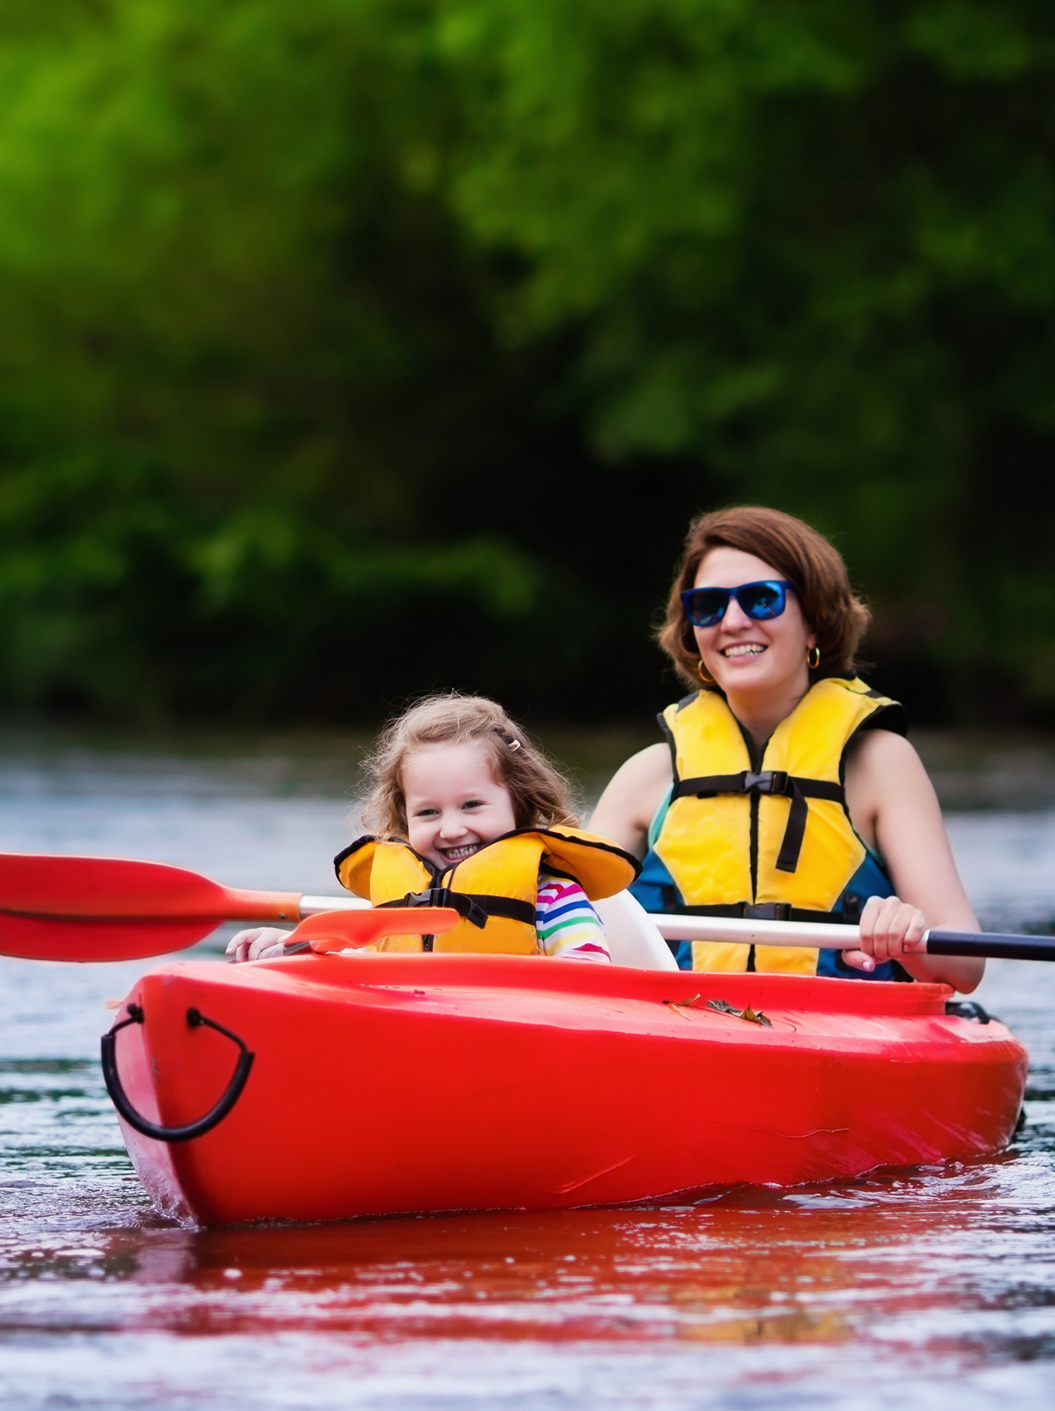
BOATING SAFETY
CONTINUED
  Develop a float plan. Let someone else know where you’re going and how long you’re going to be gone. A float plan can include the following information: name, address, and phone number of trip leader and passengers; boat type and registration information; trip itinerary; and types of communication and signal equipment aboard, such as an Emergency Position Indicating Radio Beacon (EPIRB) or Personal Locator Beacon.
  Make proper use of life jackets. Assign and fit each member of your onboard team with a life jacket before departure.
  Avoid alcohol. Operating a boat while intoxicated is illegal. Nearly half of all boating accidents involve alcohol—designate a sober skipper before leaving the dock.
  Be aware of carbon monoxide. Maintain fresh air circulation throughout the boat. Educate all passengers about the symptoms of CO poisoning and where CO may accumulate.
  Skip swimming in a marina. Never swim in a marina or in other areas where boats are connected to shore power. Stray power in the water can create an electric shock hazard.
  Stay clear of the engine. Drivers should wear the boat engine`s cut-off switch lanyard at all times. Keep watch around the propeller area when people are in he water. Never allow passengers to board or exit your boat from the water when engines are on or idling. Take extra precautions near boats towing skiers or tubers.
Click here to return to the
SUMMER SAFETY MENU
12

Slide 13
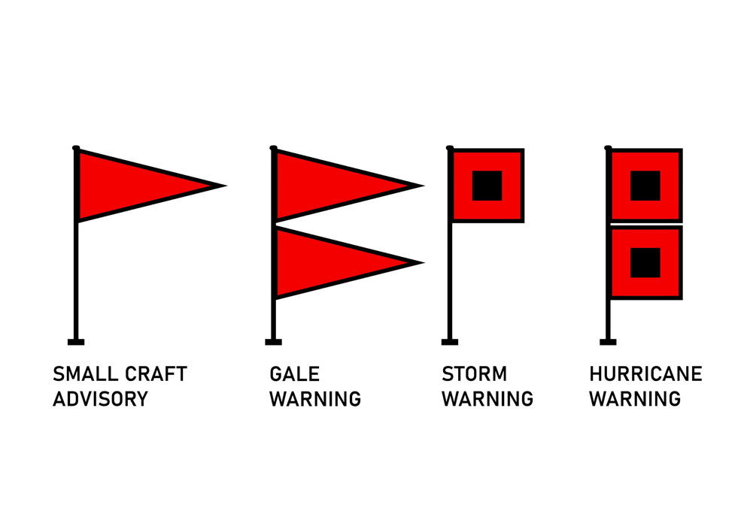

BOATING SAFETY
OBSERVE WARNING SIGNS
Maritime warning flag systems will hoist flags to provide boaters a visual indicator to current weather conditions. Below are a few to know:
  One red flag denotes a small craft advisory and two red flags indicate a gale warning.
  One red flag with a black square in the middle indicates a general storm warning.
  The use of two black-squared red flags denotes a hurricane force wind warning or a hurricane warning or tropical storm, depending on where you are located. Some lakes are big enough to create their own weather so this isn’t just for ocean-goers.
The National Weather Service generally issues a storm warning for higher winds and wind gusts of 48 knots (89 km/h; 55 mph) to 63 knots (117 km/h; 72 mph) at sea and on many lakes in the United States.
Click here to return to the
SUMMER SAFETY MENU
13

Slide 14
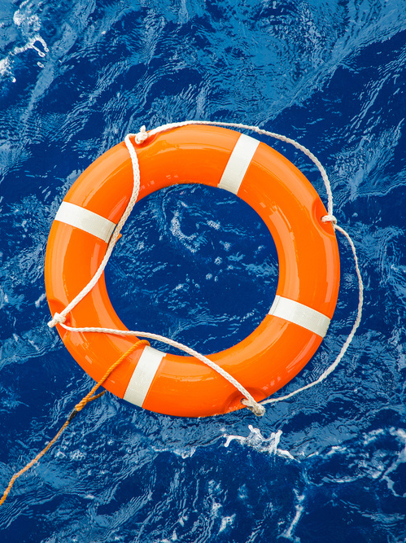
BOATING SAFETY
MAN OVERBOARD
Shout – “Man overboard!”
Spot – Locate the person in the water and keep an eye on them at all times. With waves and the boat’s movement, it’s easy to lose track of your victim.
Throw – Toss a flotation device into the water for the victim to latch onto.
Boat Turn Around* – Turn back toward the victim to pick them up.
Pull or Climb – Return to the victim’s side, toss a lifeline, and tow them in. Or you can pull the victim by the life vest into the boat. If they’re strong enough, they may be able to climb aboard via the swim ladder.
*Note: Two types of turns are used to quickly return to the point of origin: The elliptical (an oval racetrack-shaped turn) and the Williamson (most appropriate at night or in reduced visibility). We recommend conducting a search for "rescue turns" in your browser to find out how or to review.
Click here to return to the
SUMMER SAFETY MENU
14

Slide 15
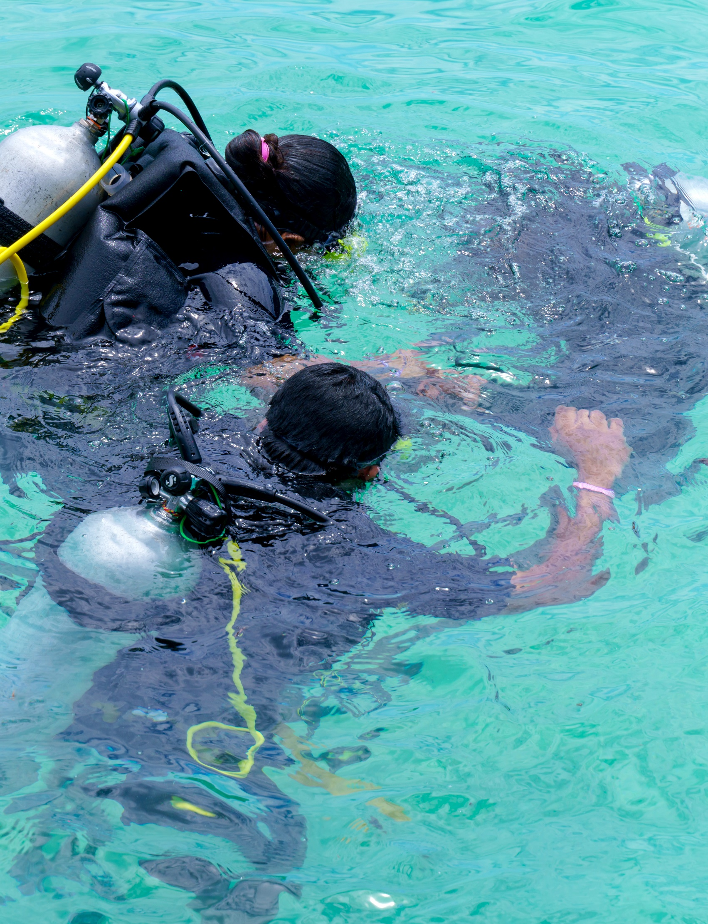
DIVING SAFETY
OBSERVE WARNING SIGNS
  Always test water depth before diving. If unable to see below water surface, don’t dive.
  Never dive into rivers or other moving bodies of water. Keep your arms extended above your head when diving.
  Don’t drink. Drinking before a dive entails a number of risks, including nitrogen narcosis, heat loss, impaired judgment, and it affects the reaction time, attention span, and visual tracking, among others.
  Don’t smoke. It’s advisable to abstain from smoking at least 12 hours before your dive.
  Get medically assessed. Some medical conditions are not compatible with diving. Even a common cold or sinus infection can prevent you from going under.
  Double check your gear. Whether you own your gear or rent it, always do a safety check. Inspect the gear for wear and tear; look for faulty zippers, cracked buckles, straps or frayed areas that could lead to leaks. Your regulator and tank should also get checked regularly for functional issues.
Disclaimer: The information offered above is designed for educational purposes only. Do not rely solely on this information; seek professional advice on all matters related to scuba diving safety. If you have any further concerns or questions, consult with your guide, dive master or diving instructor.
Click here to return to the
SUMMER SAFETY MENU
15

Slide 16
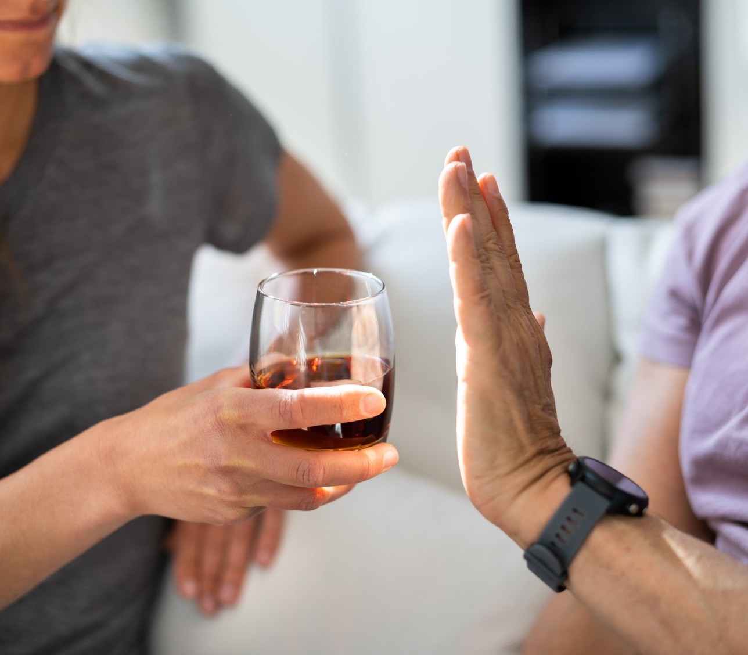

ALCOHOL SAFETY
For some, summer activities may include alcohol, but risky drinking can put a chill on summer fun, says the National Institute on Alcohol Abuse and Alcoholism. For more information on preventing problems with alcohol this summer, and tips on cutting back, visit: https://www.rethinkingdrinking.niaaa.nih.gov
Click here to return to the
SUMMER SAFETY MENU
16

Slide 17

AFLOAT DRINKING
NOT WORTH THE RISK
  The U.S. Coast Guard reports that alcohol use contributes to 19% of boating deaths in which the primary cause is known, making alcohol the leading known contributor of fatal boating accidents.
  70% of water recreation deaths involve alcohol (Centers for Disease Control).
DID YOU KNOW?
A boat operator is likely to become impaired quicker than a driver.
The penalties for Boating Under the Influence (BUI) can include significant fines, revocation of operator privileges and severe jail terms.
Click here to return to the
SUMMER SAFETY MENU
17

Slide 18
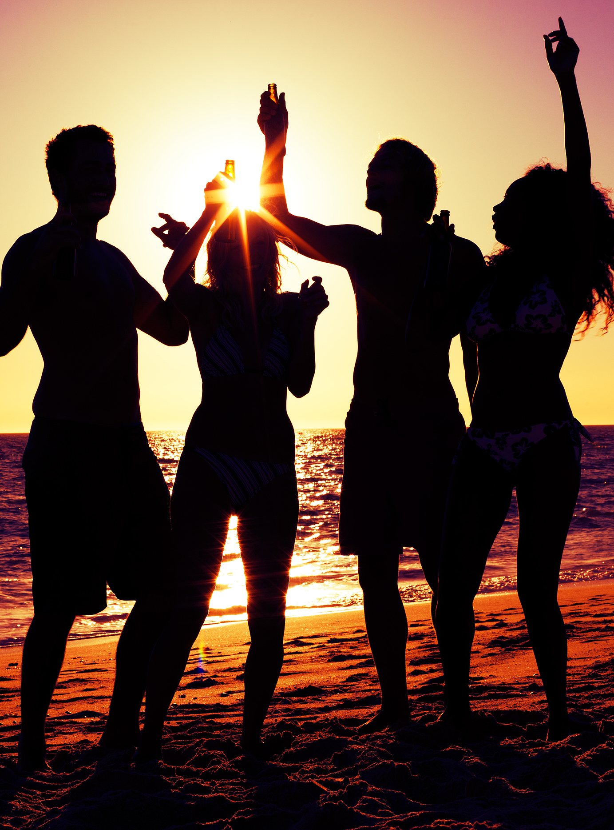
MIXING SUN AND ALCOHOL
BOTH ALCOHOL AND THE SUN CAN CAUSE DEHYDRATION
The sun causes your body to sweat to stay cool, and if those fluids aren’t replaced, your body will undergo adverse reactions. You may feel extremely thirsty, dizzy or fatigued.
When people drink they may become lackadaisical and reckless, which can have dangerous implications when water is involved.
If you are drinking in or near a body of water be aware that you may lack the dexterity needed to stay afloat, which can increase your risk of drowning (the third leading cause of unintentional injury and death worldwide and fifth in the United States). Sun and heat exposure only amplifies this risk.
Also, the physical exertion of swimming on a hot day paired with alcohol consumption can lead to overheating – a risk factor for heat syncope (fainting), which can have deadly consequences.
Click here to return to the
SUMMER SAFETY MENU
18

Slide 19
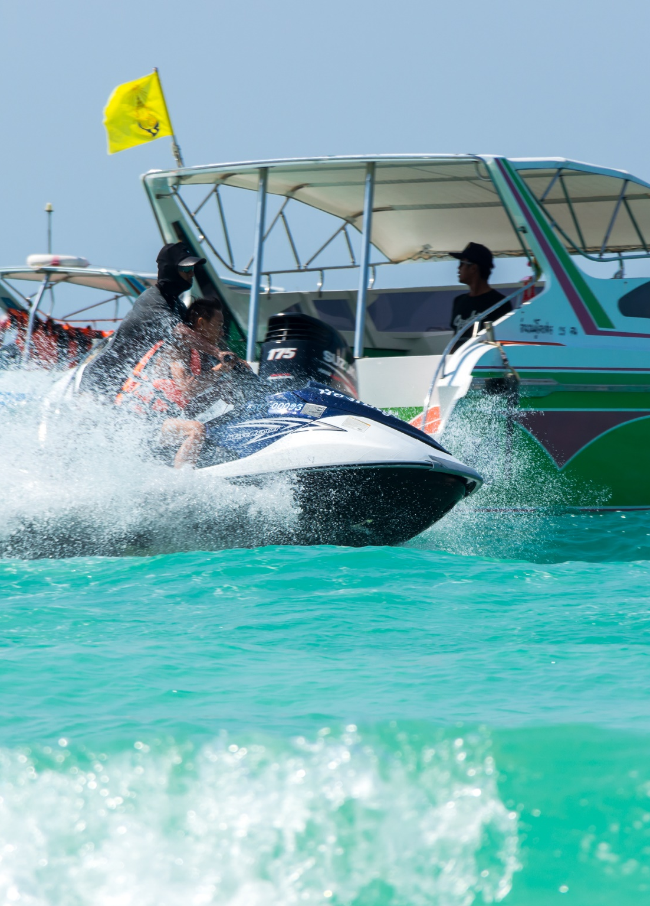
BOATERS' HYPNOSIS
FATIGUE CAUSED BY HOURS OF BOATING
Boat U.S. Foundation: "Stressors, such as exposure to noise, vibration, sun, glare, wind, and the motion of the water, affect boat operators and passengers, thus drinking while boating is even more dangerous than drinking and driving.
"Research shows that hours of exposure to boating stressors produces a kind of fatigue or ‘boater’s hypnosis,’ which slows reaction time almost as much as if you were legally drunk. Adding alcohol or drugs to boating stress factors intensifies their affects each drink multiplies your accident risk."
That’s why boaters should never drink when operating a boat. Every state has strict drinking and boating laws – you can be arrested on the water. Yes, you can get a BUI punishable using the same criteria as Driving Under the Influence (DUI).
Click here to return to the
SUMMER SAFETY MENU
19

Slide 20
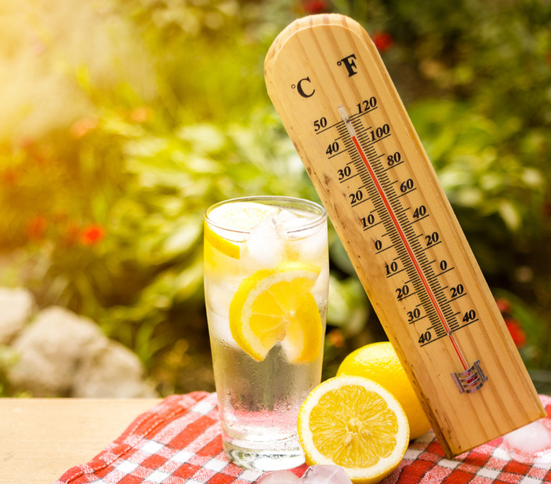
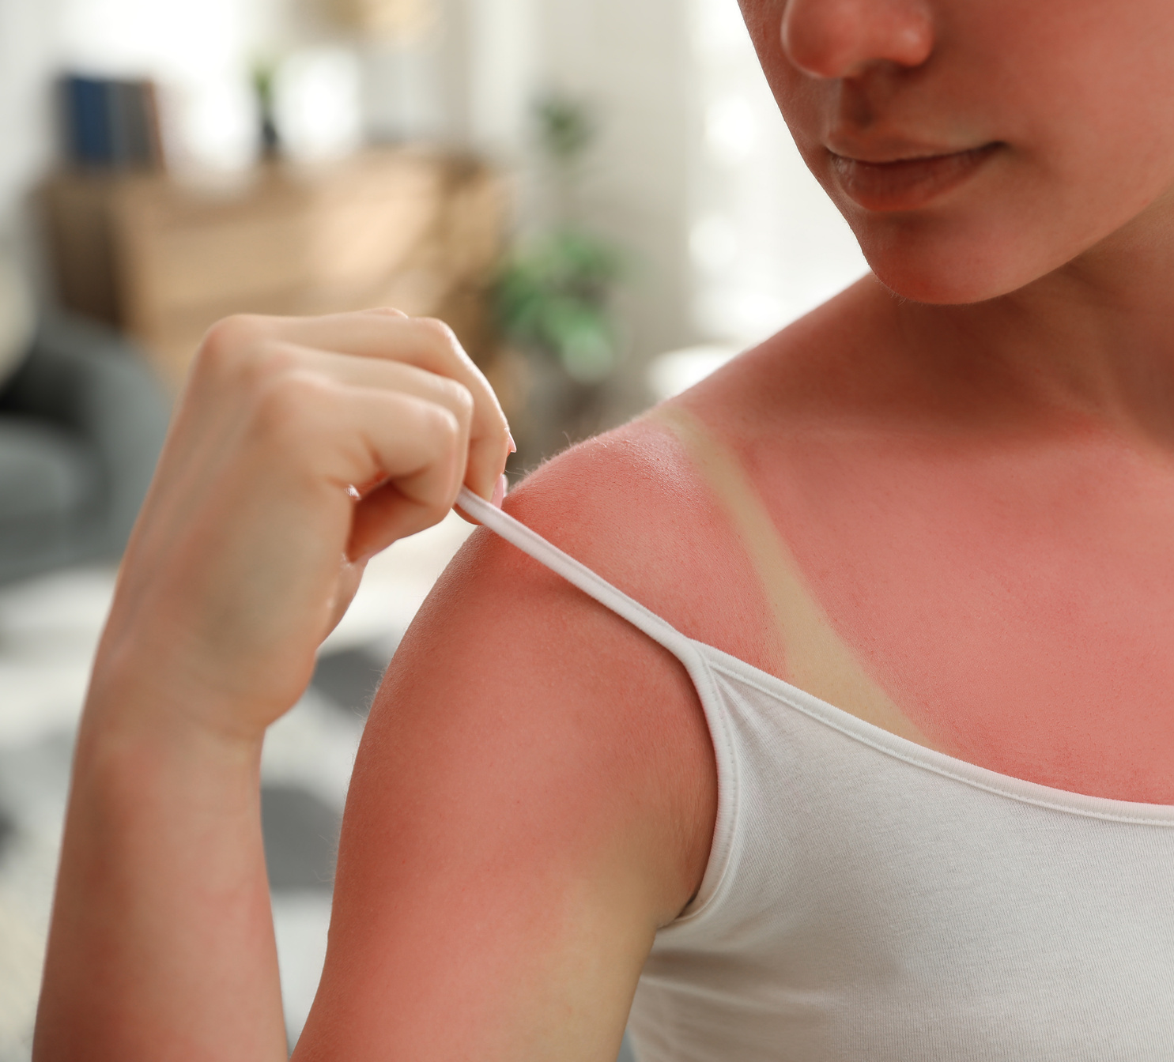
HEAT AND SUN SAFETY
In the U.S. an average of 1,875 heat-related deaths occurred between 2021-2023, according to the U.S. Department of Health and Human Services.
Click here to return to the
SUMMER SAFETY MENU
20

Slide 21
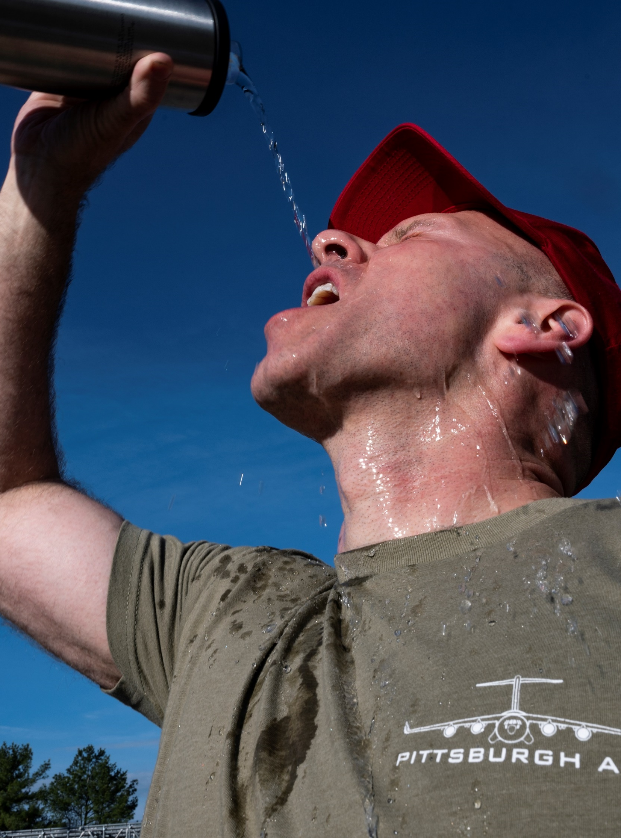
HEAT-RELATED ILLNESS
HEAT EXHAUSTION AND HEAT STROKE CAN ESCALATE QUICKLY
Heat Related Illnesses:
Sunburn
Heat Cramps
Heat Exhaustion
Heat Stroke
Definition:
Heat-related illness, or hyperthermia, is a condition resulting from exposure to extreme heat where the body becomes unable to properly cool, resulting in a rapid rise in body temperature.
The evaporation of sweat is the normal way to remove body heat, but, when the humidity is high, sweat does not evaporate as quickly. This, in turn, prevents the body from releasing heat quickly.
Prompt treatment of heat-related illnesses with aggressive fluid replacement and cooling of core body temperature is critical to reducing illness and preventing death.
Click here to return to the
SUMMER SAFETY MENU
21

Slide 22
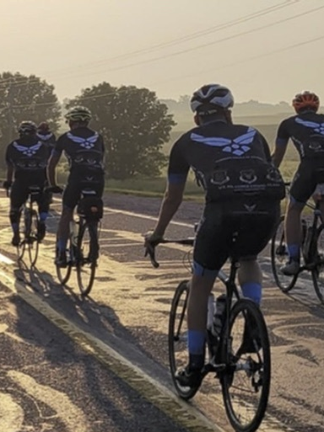
HEAT SAFETY TIPS
SURVIVING THE HOT WEATHER
WHAT YOU CAN DO:
  During heat waves, frequently check on people at risk for heat-related death, such as the elderly and disabled or homebound people.
  Never leave children alone in cars and ensure children cannot lock themselves in an enclosed space, such as a car trunk.
  Limit sun exposure during midday hours and in places of potential severe exposure, such as beaches.
  Drink plenty of nonalcoholic fluids and replace the body’s salts and minerals, which sweating can release. Do not take salt tablets unless under medical supervision.
  Dress infants and children in cool, loose clothing and shade their heads and faces from the sun with hats or an umbrella.
  Provide plenty of fresh water for pets and leave the water in a shady area.
Click here to return to the
SUMMER SAFETY MENU
22

Slide 23
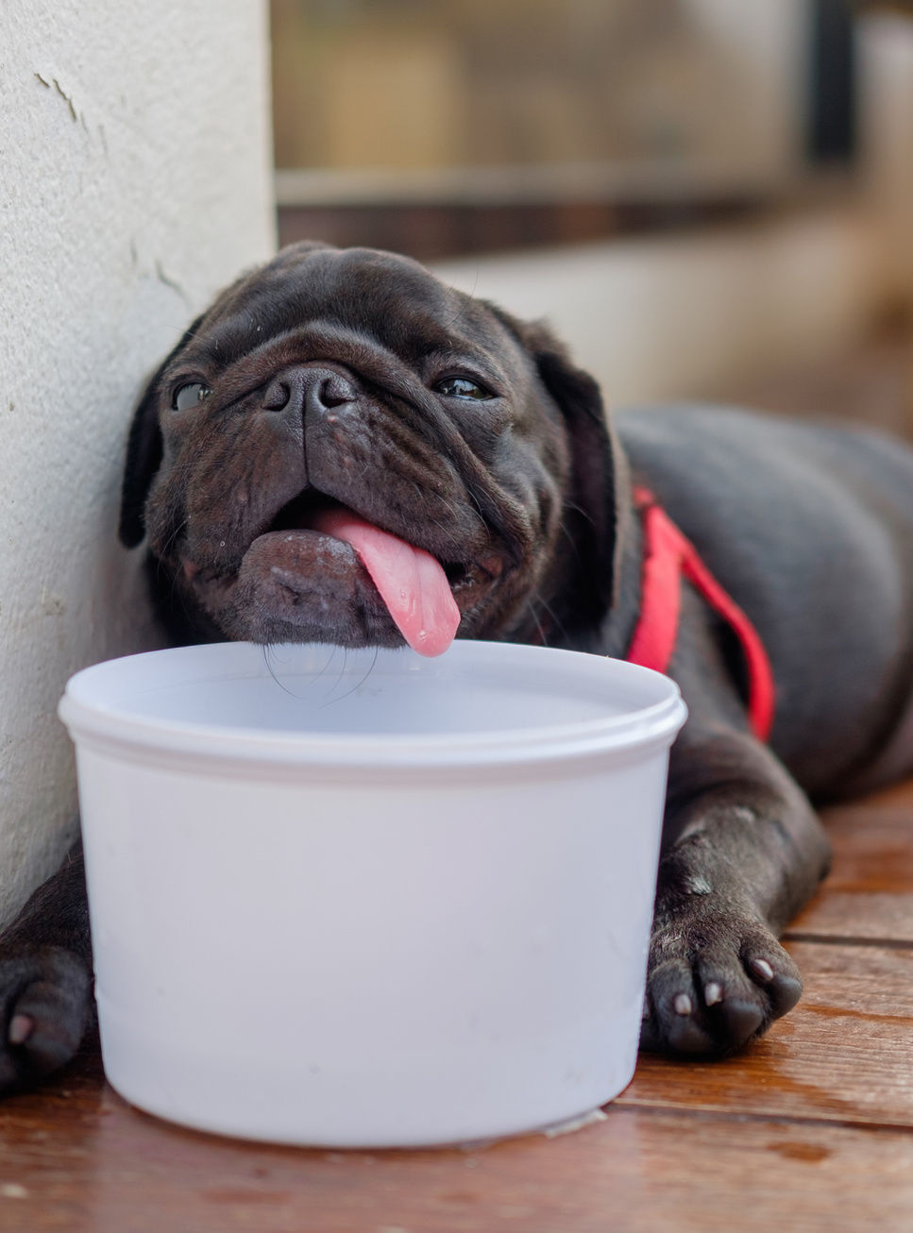
HEAT SAFETY TIPS
CONTINUED
TREATMENT:
  Reduce body temperature by cooling the body.
  Remove unnecessary clothing.
  Apply water, cool air, wet sheets, or ice on the neck, groin and armpits to accelerate cooling.
  Seek professional medical attention immediately!
PREVENTION:
  Stop physical activity and move to a cool place.
  Drink water or drinks with electrolytes.
  Wait for cramps to go away before you do any more physical activity.
GET MEDICAL HELP RIGHT AWAY IF:
  Cramps last longer than one hour.
  You’re on a low-sodium diet.
  You have heart problems.
Click here to return to the
SUMMER SAFETY MENU
23

Slide 24
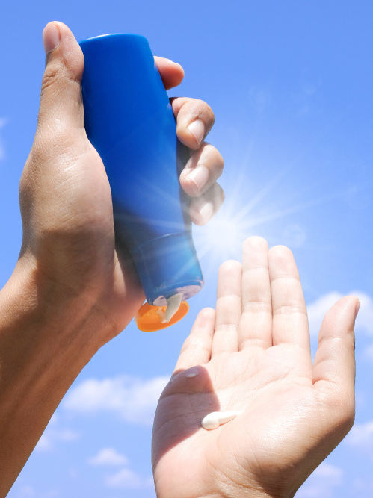
SUN SAFETY
SUN'S UV RAYS CAN DAMAGE SKIN IN 15 MINUTES
Use broad spectrum sunscreen with sun protection factor (SPF) 15 or higher before you go outside, even on slightly cloudy or cool days. Don’t forget to put a thick layer on all parts of exposed skin. Get help for hard-to-reach places like your back. And remember, sunscreen works best when combined with other options to prevent UV damage.
Reapplication. Sunscreen wears off. Put it on again if you stay out in the sun for more than two hours and after swimming, sweating, or toweling off.
Expiration date. Check the sunscreen’s expiration date. Sunscreen without an expiration date has a shelf life of no more than three years, but its shelf life is shorter if it is exposed to high temperatures.
Cosmetics. Some makeup and lip balms contain some of the same sun-protective ingredients used in sunscreens. If they do not have SPF 15 or higher, be sure to use other forms of protection as well, such as sunscreen and a wide-brimmed hat.
Click here to return to the
SUMMER SAFETY MENU
24

Slide 25
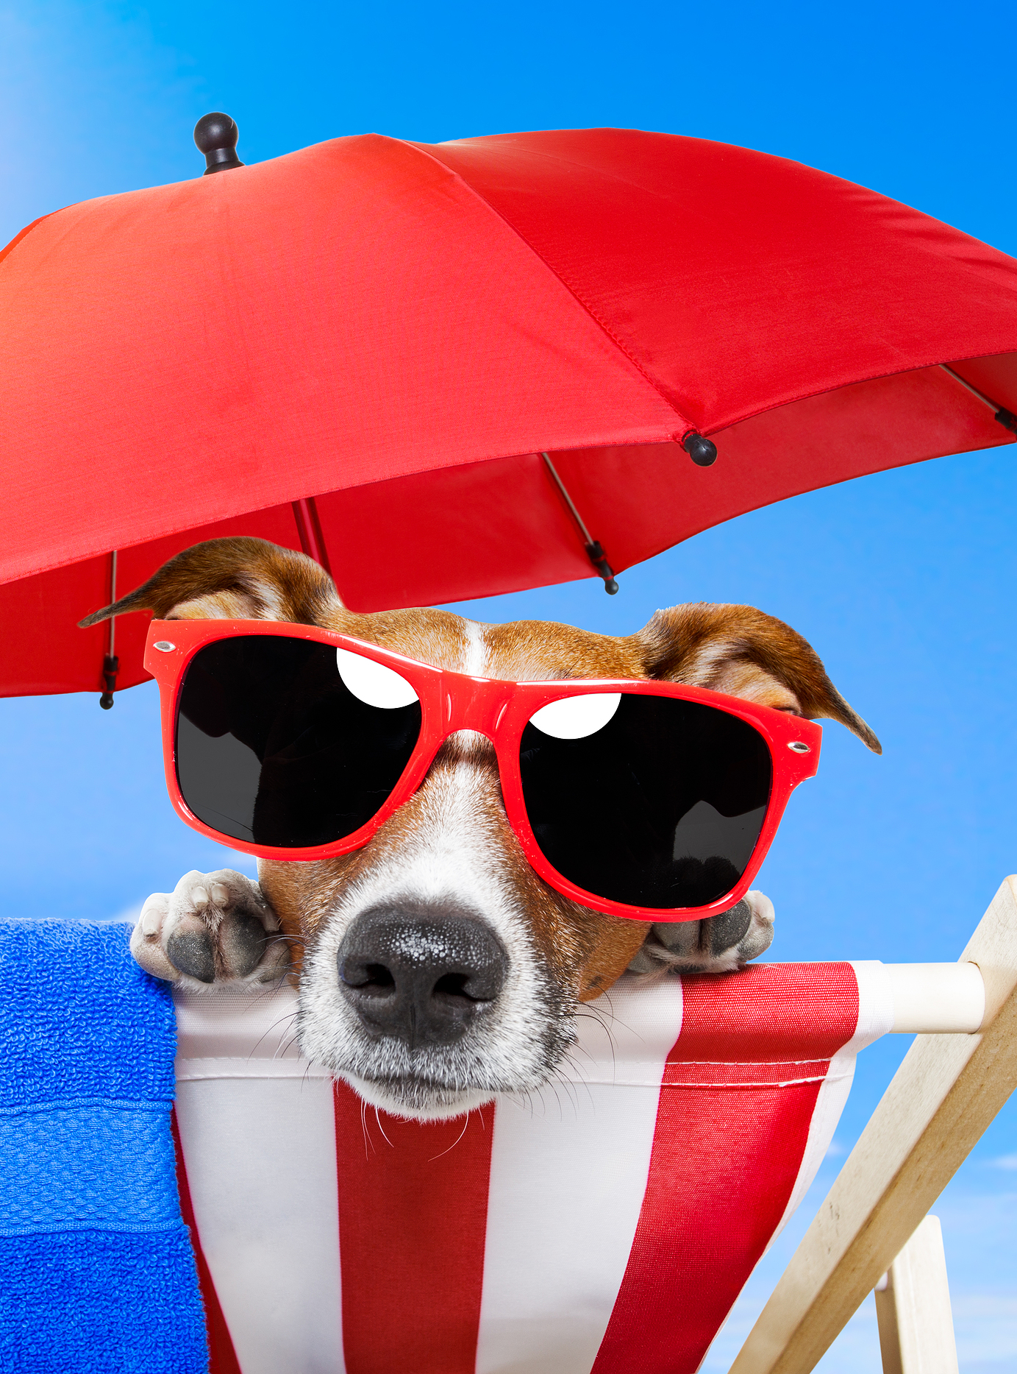
SUN SAFETY
CONTINUED
Shade, Clothing, Hat and Sunglasses
You can reduce your risk of skin damage and skin cancer by seeking shade under an umbrella, tree, or other shelter before you need relief from the sun.
When possible, long-sleeved shirts and long pants and skirts can provide protection from UV rays. For the most protection, wear a hat with a brim all the way around that shades your face, ears, and the back of your neck. A tightly woven fabric, such as canvas, works best to protect your skin from UV rays. Avoid straw hats with holes that let sunlight through. A darker hat may offer more UV protection.
Sunglasses protect your eyes from UV rays and reduce the risk of cataracts. They also protect the delicate skin around your eyes from sun exposure.
Click here to return to the
SUMMER SAFETY MENU
25

Slide 26


FIREWORKS SAFETY
The National Safety Council recommends enjoying fireworks at public displays conducted by professionals, and not use any fireworks at home. Even though fireworks may be legal, they pose a high risk to personal safety.
Click here to return to the
SUMMER SAFETY MENU
26

Slide 27

GENERAL FIREWORKS RULES
(IF FIREWORKS ARE LEGAL WHERE YOU RESIDE)
  Never use fireworks while impaired by drugs or alcohol.
  Anyone using fireworks or standing nearby should wear protective eyewear.
  Never hold lighted fireworks in your hands.
  Never light them indoors.
  Only use them away from people, houses and flammable material.
  Never point or throw fireworks at another person.
  Only light one device at a time and maintain a safe distance after lighting.
  Never ignite devices in a container.
  Do not try to re-light or handle malfunctioning fireworks.
  Soak both spent and unused fireworks in water for a few hours before discarding.
  Keep bucket of water nearby to extinguish fireworks that don't go off or in case of fire.
  Never allow young children to handle fireworks.
  Older children should use them only under close adult supervision.
  Never use illegal fireworks.
Click here to return to the
SUMMER SAFETY MENU
27

Slide 28
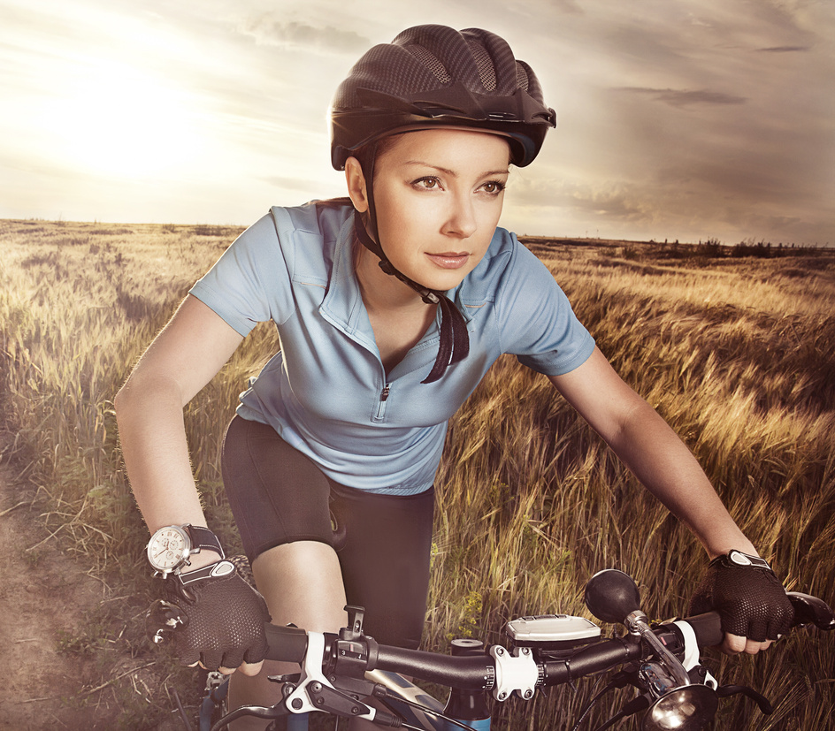
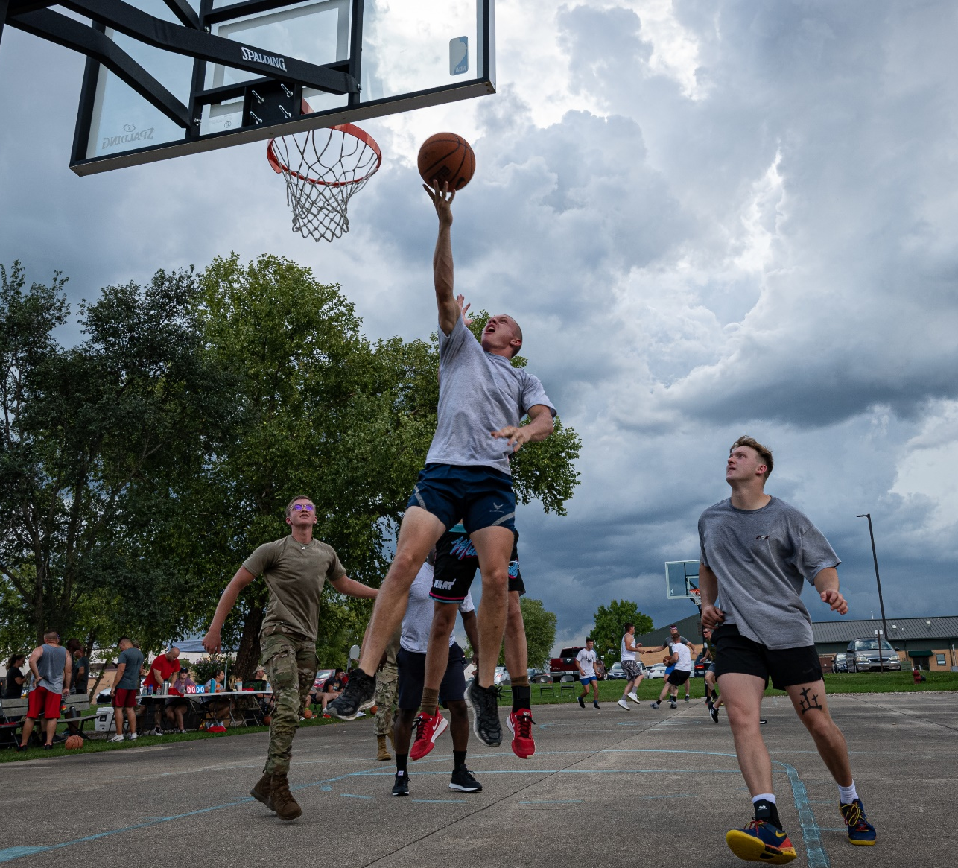
SPORTS-RELATED ACTIVITIES
In 2022, sports and recreation injuries increased 12% from 2021 in the U.S. The top three sports, activities and equipment with most injuries were:
1 - Exercise and exercise equipment
2 - Bicycles and accessories
3 - Basketball
Click here to return to the
SUMMER SAFETY MENU
28

Slide 29
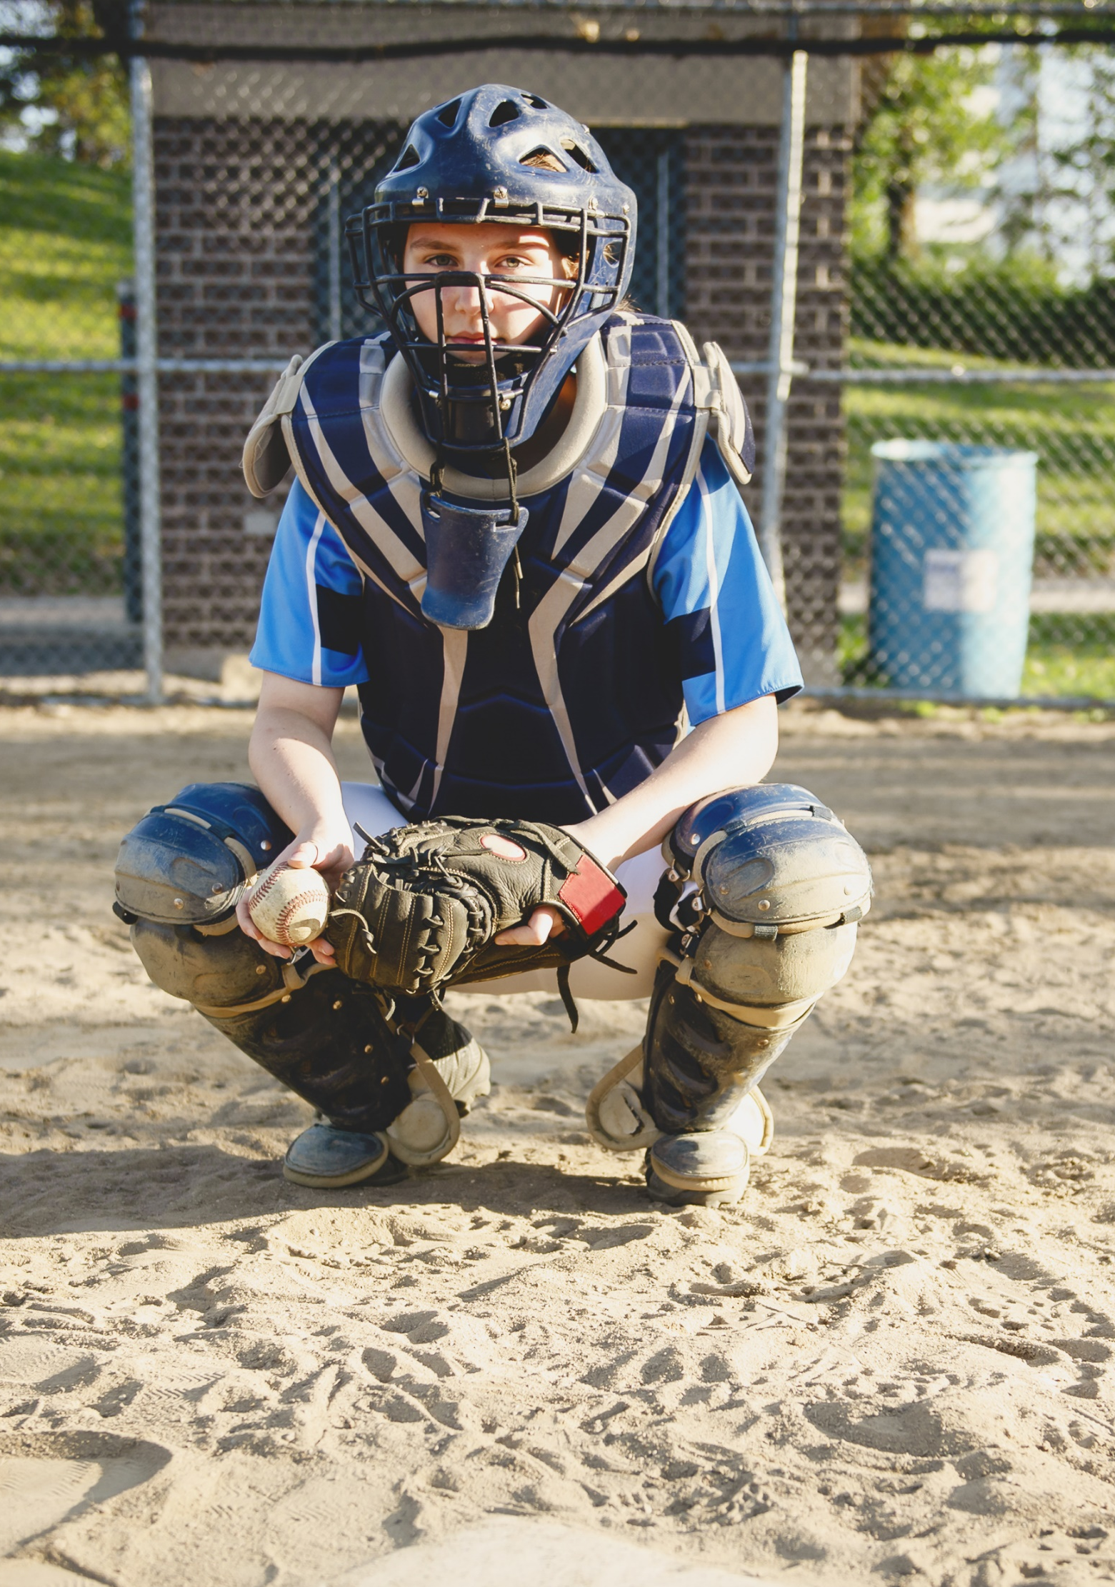
SPORTS INJURY PREVENTION
ENSURE YOU ARE PHYSICALLY ABLE
  Warm up and stretch before playing any sport.
  Ensure you are physically able to play – see your physician for periodic physicals. Don’t participate in a sporting event without a physician’s release if you’ve had a sports injury that required medical attention.
  Make sure to wear all proper protective equipment required for the sport: Shoulder pads, elbow pads, knee pads and helmet for football; batting helmets with faceguards; catcher’s face mask, throat guard, chest protector and shin guards for baseball.
  Be sure sports protective equipment is in good condition, fits appropriately and is worn correctly all the time. Avoid missing or broken buckles or compressed or worn padding. Poorly fitting equipment may be uncomfortable and may not offer the best protection.
Click here to return to the
SUMMER SAFETY MENU
29

Slide 30
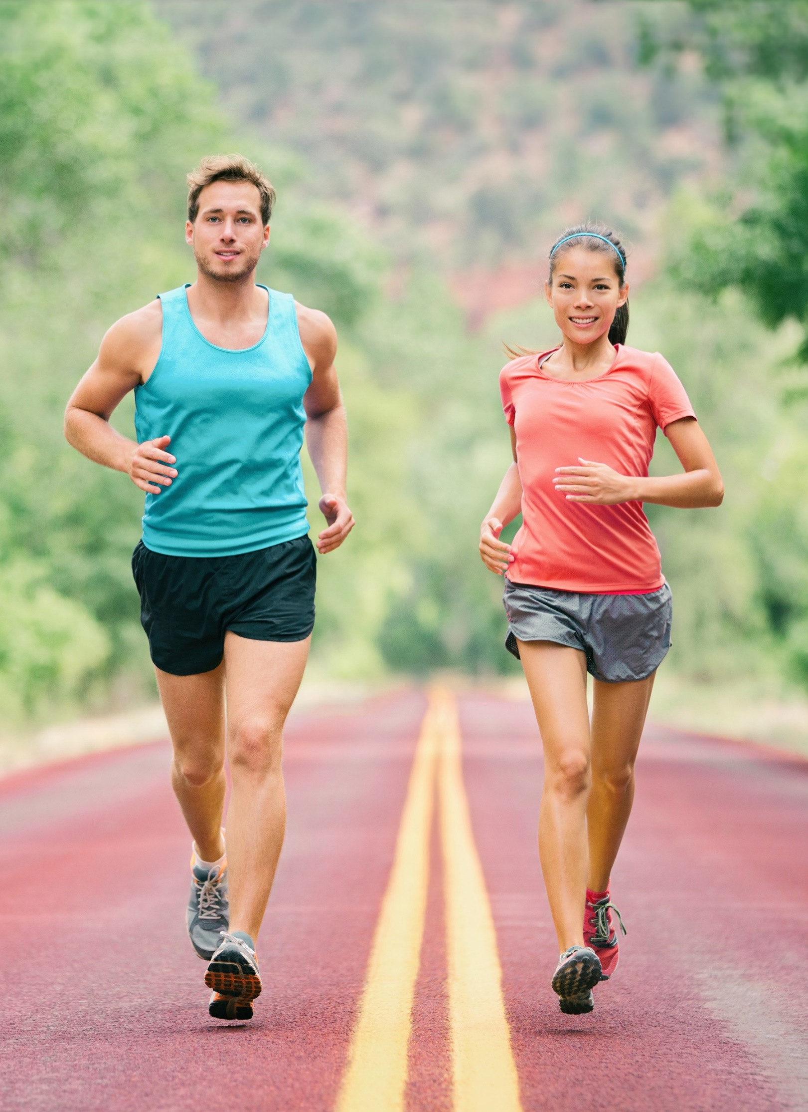
CARDIO ACTIVITIES
WALKING, JOGGING AND EXERCISING SAFELY FOR HEALTH
Follow our tips to ensure that your jogs are rewarding and safe:
  Execute warm up exercise before walking, jogging or running.
  Choose good shoes for walking, jogging or running.
  Drink plenty of fluids (water or drinks with electrolytes) before, during and after.
  Watch for signs of heat cramps, heat exhaustion or heat stroke.
  Allow a cool down period.
  Walk, jog or run on sidewalks facing traffic. Exercise caution when walking, jogging, or running, near roadways.
  Wear bright-colored clothing to improve your visibility.
Click here to return to the
SUMMER SAFETY MENU
30

Slide 31
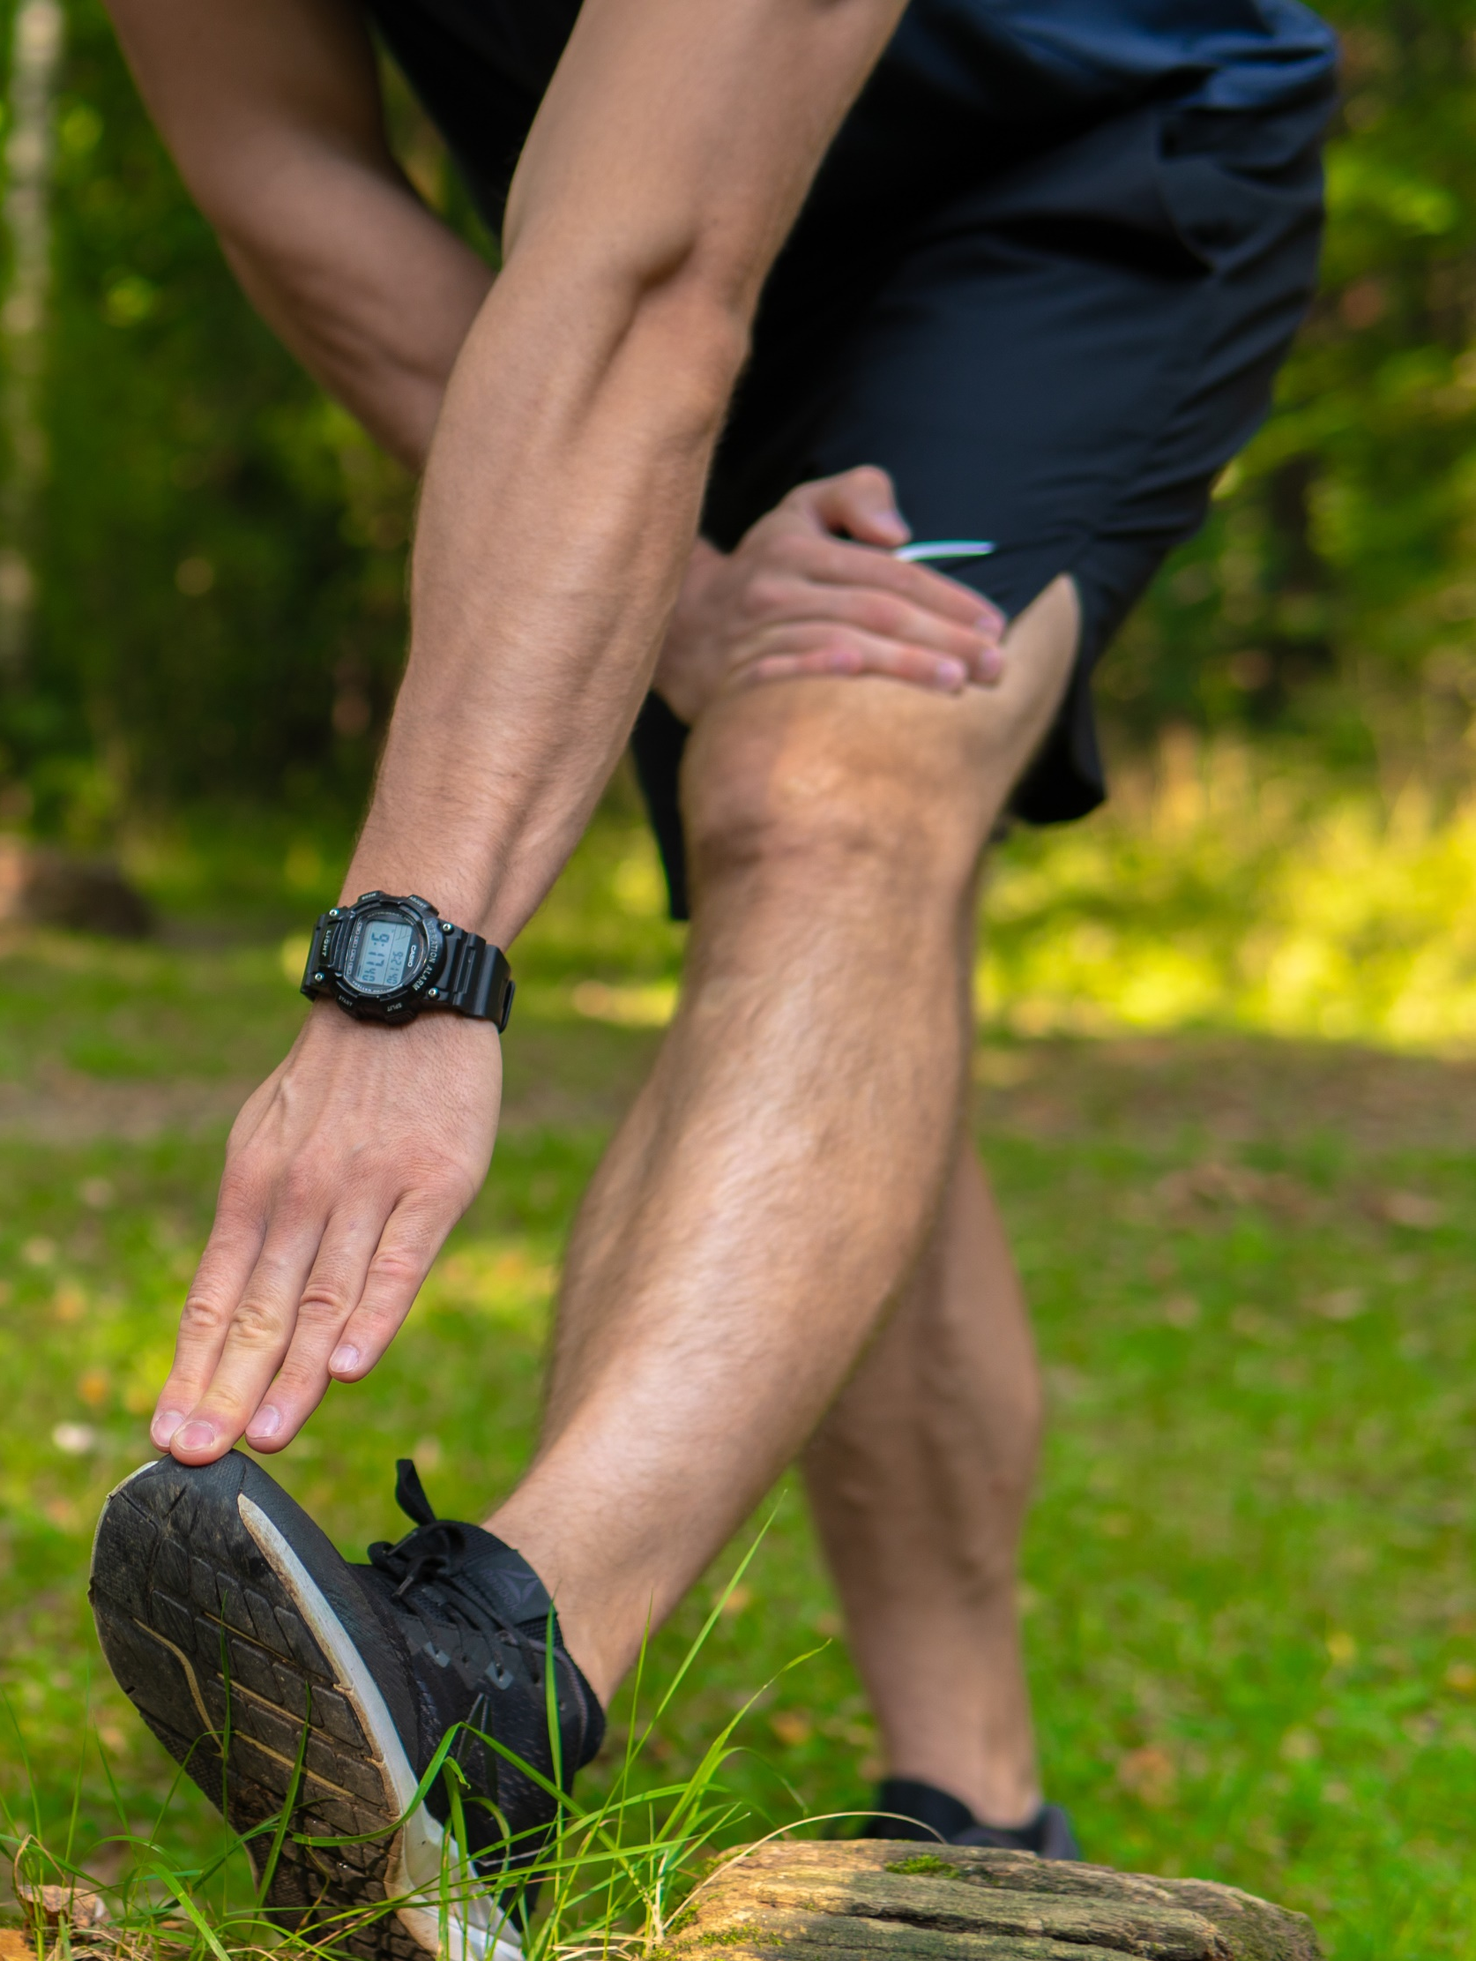
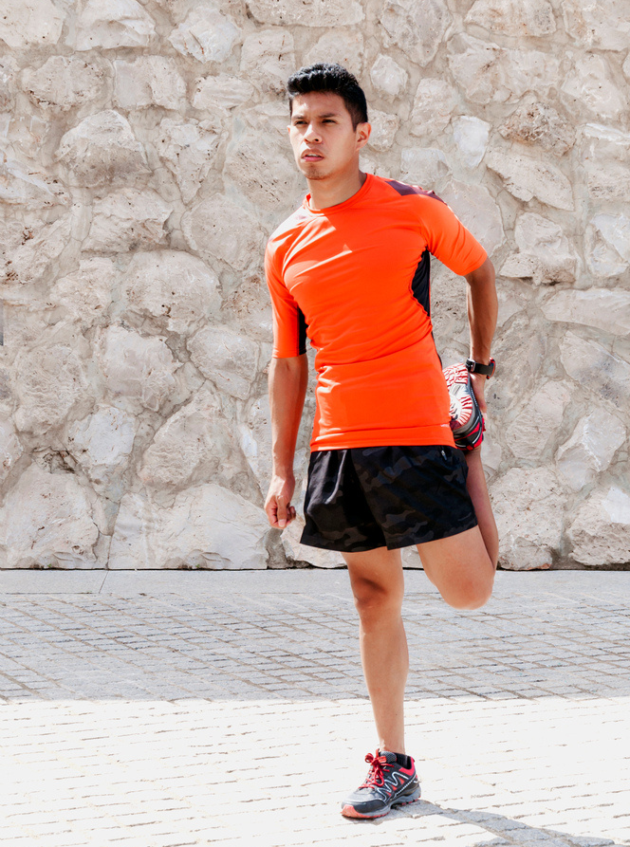
CARDIO ACTIVITIES
WALKING, JOGGING AND EXERCISING SAFELY FOR SECURITY
  Jog in a familiar area but vary your routes. Changing the route you take will prevent someone from noting your schedule or movements.
  Jog in open spaces, away from bushes or alcoves where someone could hide.
  Carry your ID. If you suspect you’re being followed, call the police immediately and find a safe place to wait for them to arrive.
  Carry a whistle or shrill alarm to summon help if needed.
  Take a key with you. Don’t leave your house unlocked.
  Do not run with your phone or other valuables in sight.
  Avoid jogging in secluded areas or at night. If you do run after dark, do so in well-lit and populated areas and consider buying reflective running gear or a runner’s light so you’re highly visible to traffic.
  Recruit a friend. Runners in pairs or groups are less appealing targets.
Click here to return to the
SUMMER SAFETY MENU
31

Slide 32
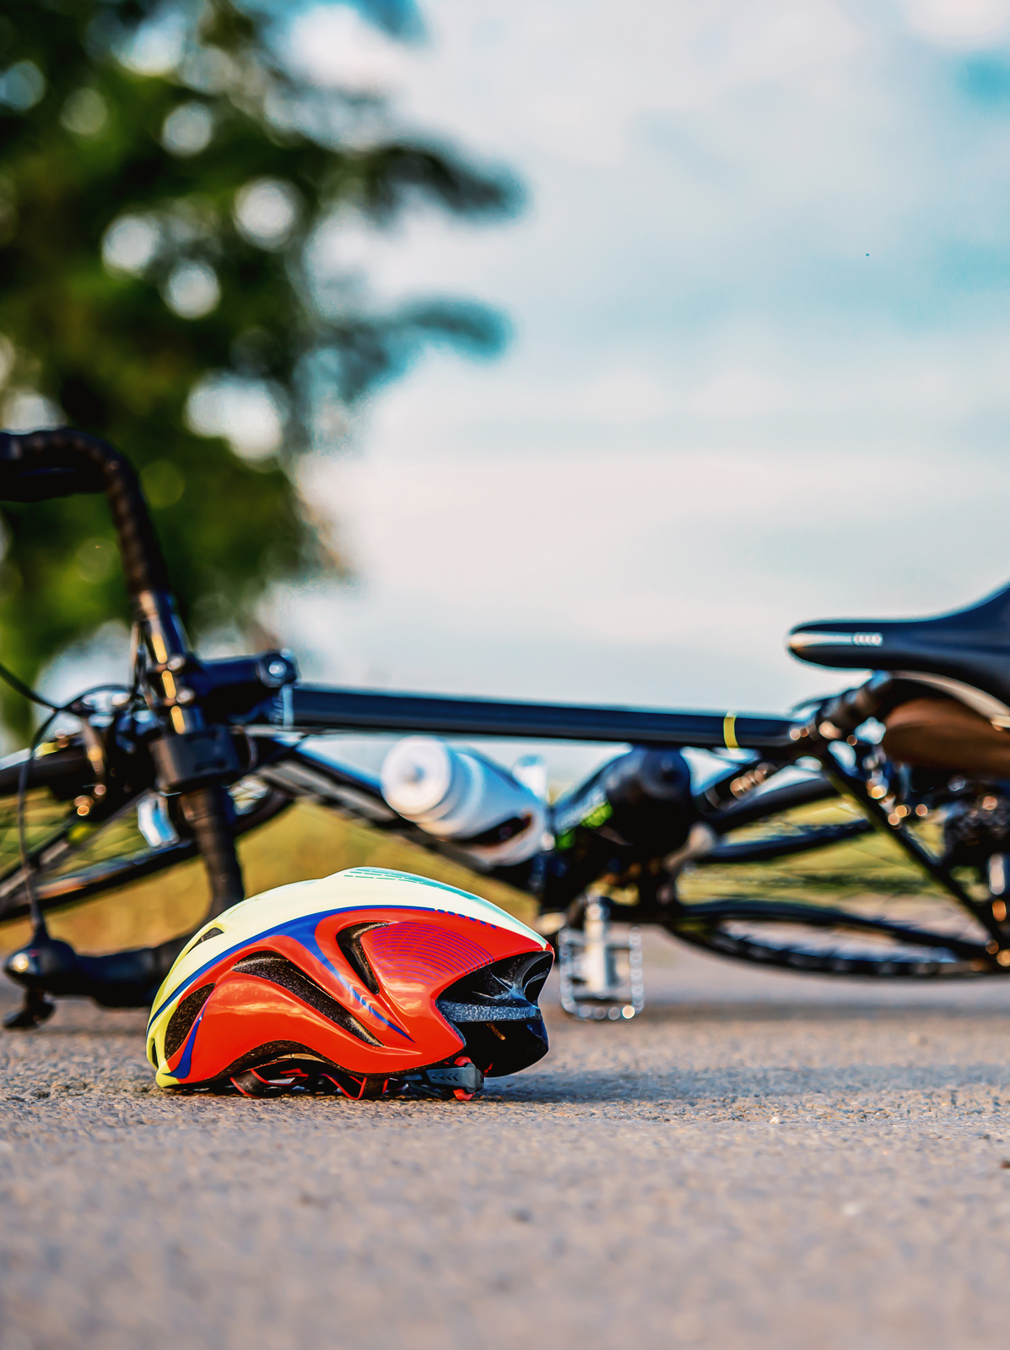
CARDIO ACTIVITIES
BIKING SAFELY
When a crash occurs between a vehicle and a bike, it’s the cyclist who is most likely to be injured. A large percentage of crashes can be avoided if motorists and cyclists follow the rules of the road and watch out for each other.
  Wear equipment to protect you and make you more visible to others, like an approved bike helmet, bright clothing (during the day), reflective gear, and a white front light and red rear light and reflectors on your bike (at night or when visibility is poor).
  Remember to use arm and hand signals.
  Ride with traffic, not against it.
  Avoid riding at night, if possible. If you must ride at night, install front and rear lights on your bicycle and wear reflective clothing. It’s the law! Regardless of the season, bicyclist deaths occurred most often between 6 p.m. and 9 p.m.
Click here to return to the
SUMMER SAFETY MENU
32

Slide 33
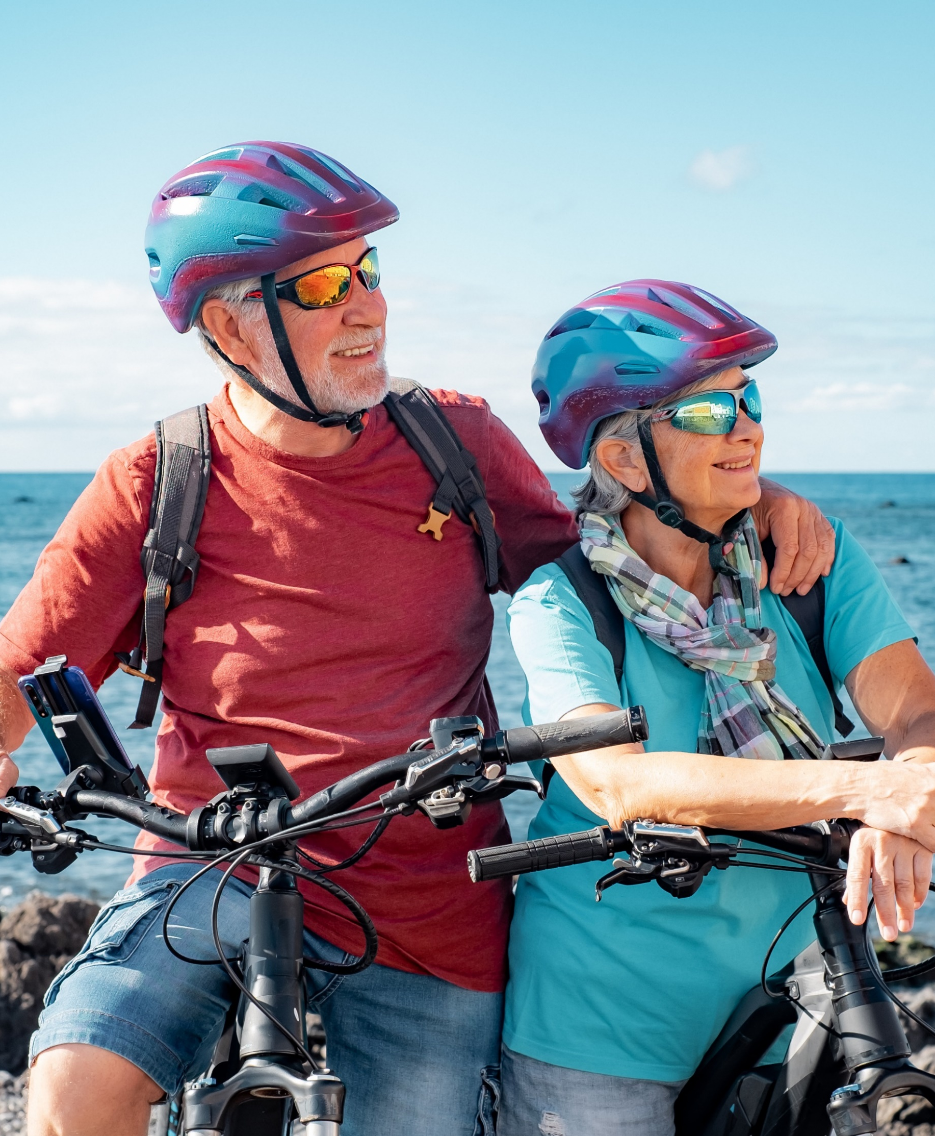
CARDIO ACTIVITIES
BIKING SAFELY CONTINUED
  Of the 1,230 bicyclist deaths in 2021, 853 died in motor-vehicle crashes and 377 in other non-traffic incidents, according to National Center for Health Statistics mortality data. Males accounted for 88% of all bicycle deaths, over eight times the fatalities for females.
  Bicycle-related deaths peak in the warmer months, starting in July, and they remain high through October. In 2021, the most deaths occurred in September (149) and the fewest in February (60).
  https://injuryfacts.nsc.org/home-and-community/safety-topics/bicycle-deaths/
  Ride a bike that fits you. If it’s too big, it’s harder to control the bike.
  Carry all items in a backpack or strapped to the back of the bike.
  Tuck and tie your shoelaces and pant legs so they don’t get caught in your bike chain.
  Plan your route, choose routes with less traffic and slower speeds. Your safest route may be away from traffic altogether, in a bike lane or on a bike path.
Click here to return to the
SUMMER SAFETY MENU
33

Slide 34
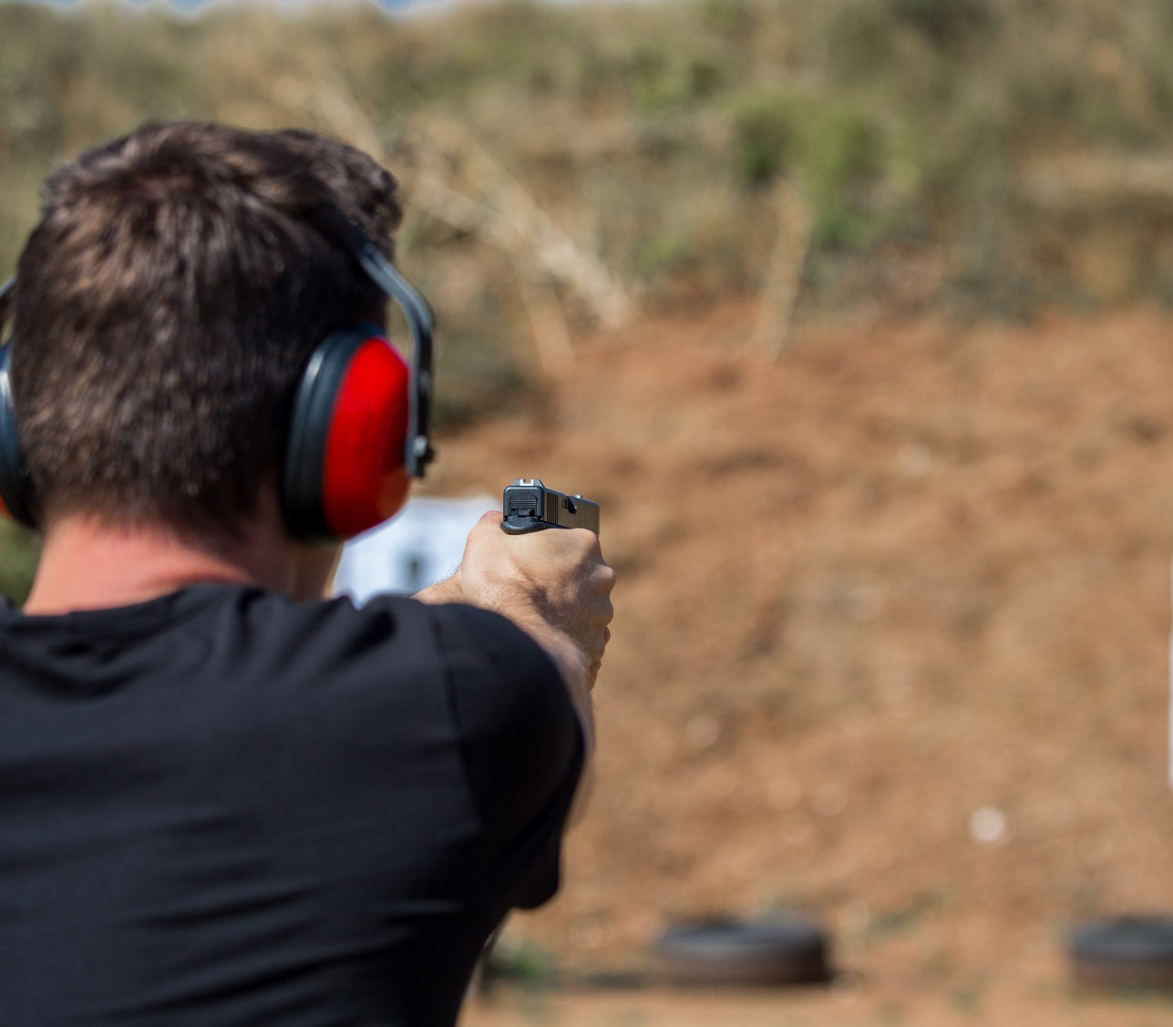
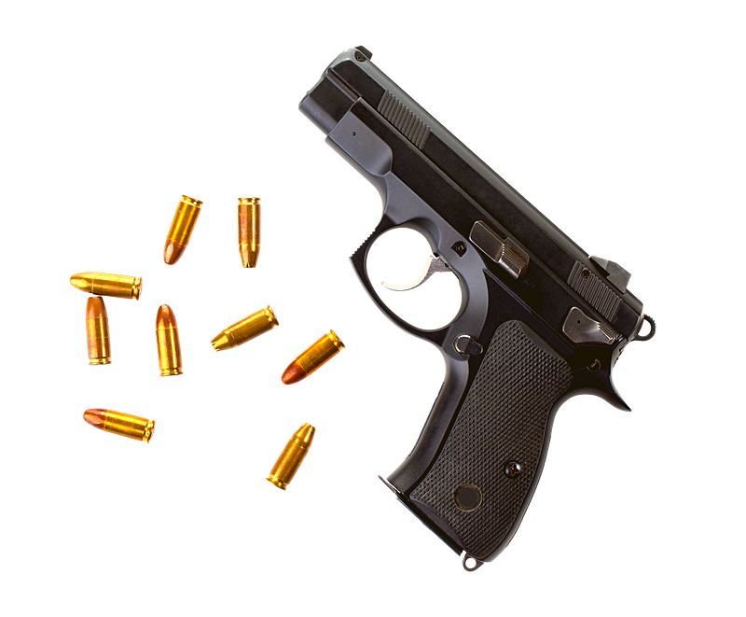
FIREARMS SAFETY
Preventable or accidental gun-related decreased 16% in 2022. However, from 2013 to 2022, preventable gun-related deaths decreased nearly 9%, from 505 to 461 deaths. (Source: National Safety Council)
Click here to return to the
SUMMER SAFETY MENU
34

Slide 35
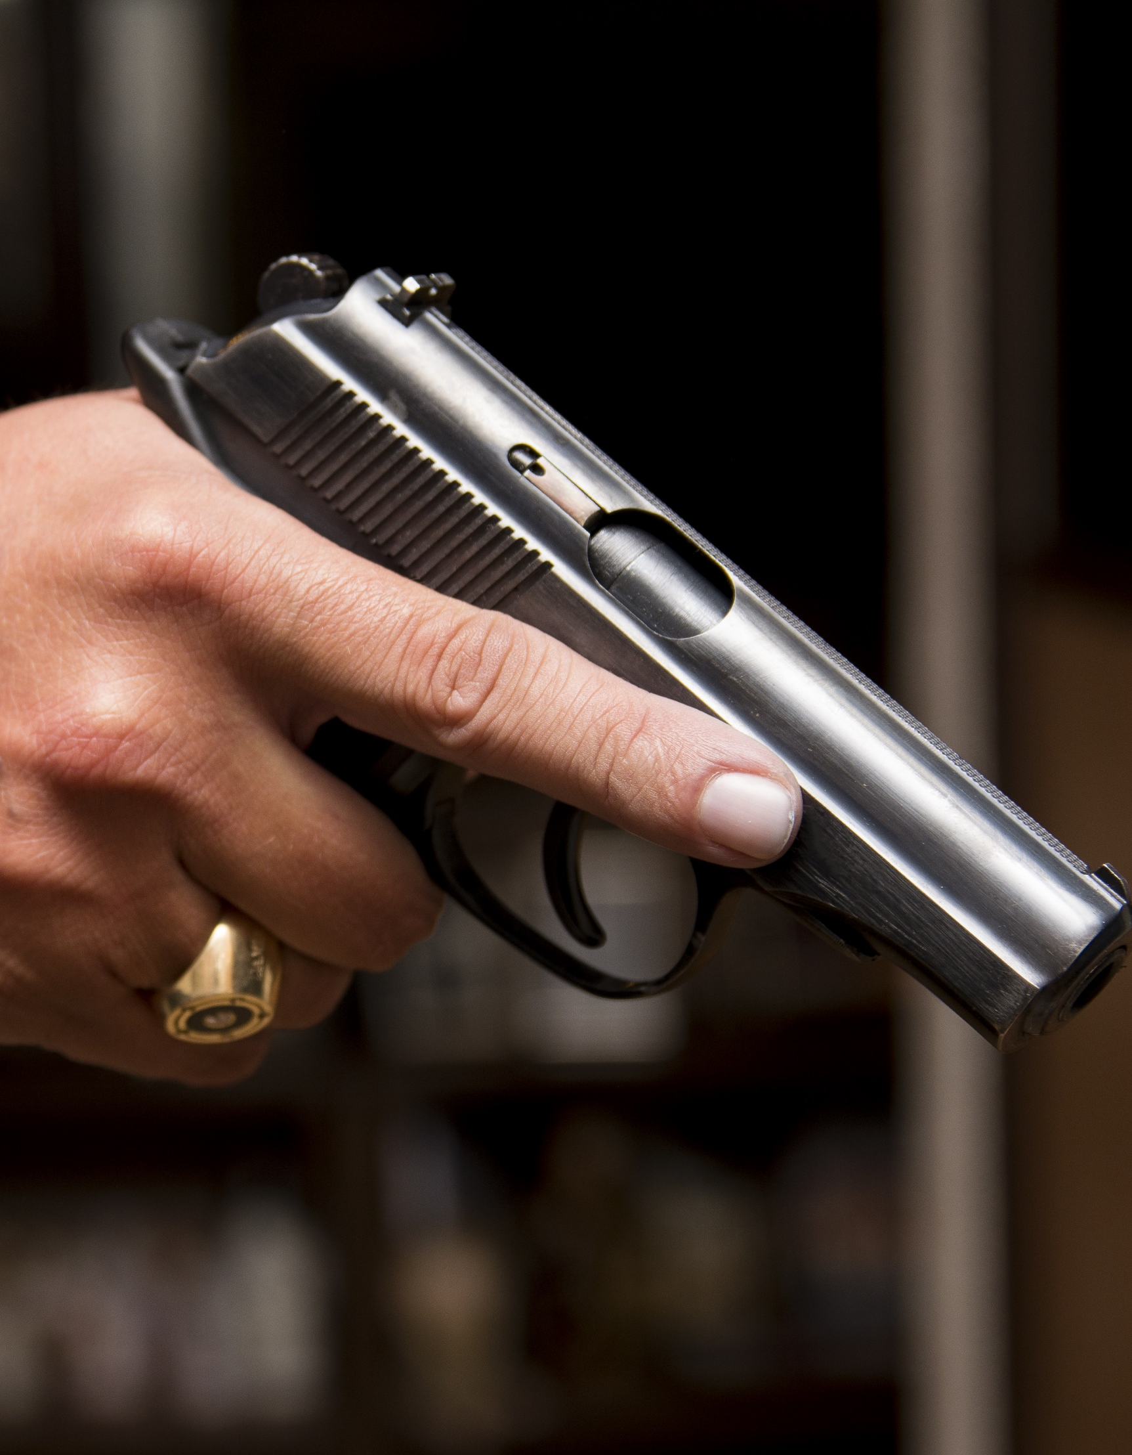
HANDLE FIREARMS SAFELY
AVOID COMPLACENCY WITH PRIVATELY-OWNED FIREARMS
  Handle every firearm as if loaded.
  Never point the muzzle at anything you don’t intend to shoot.
  Alcohol and firearms don’t mix: Do not handle firearms while, or after, consuming alcohol.
  Know your firearm.
  Make sure you read the owner’s manual and take a class.
  Everyone is a safety officer.
  Intervene when you see someone handling a firearm improperly.
  Handle every firearm with care.
  Identify the target before you fire.
Click here to return to the
SUMMER SAFETY MENU
35

Slide 36
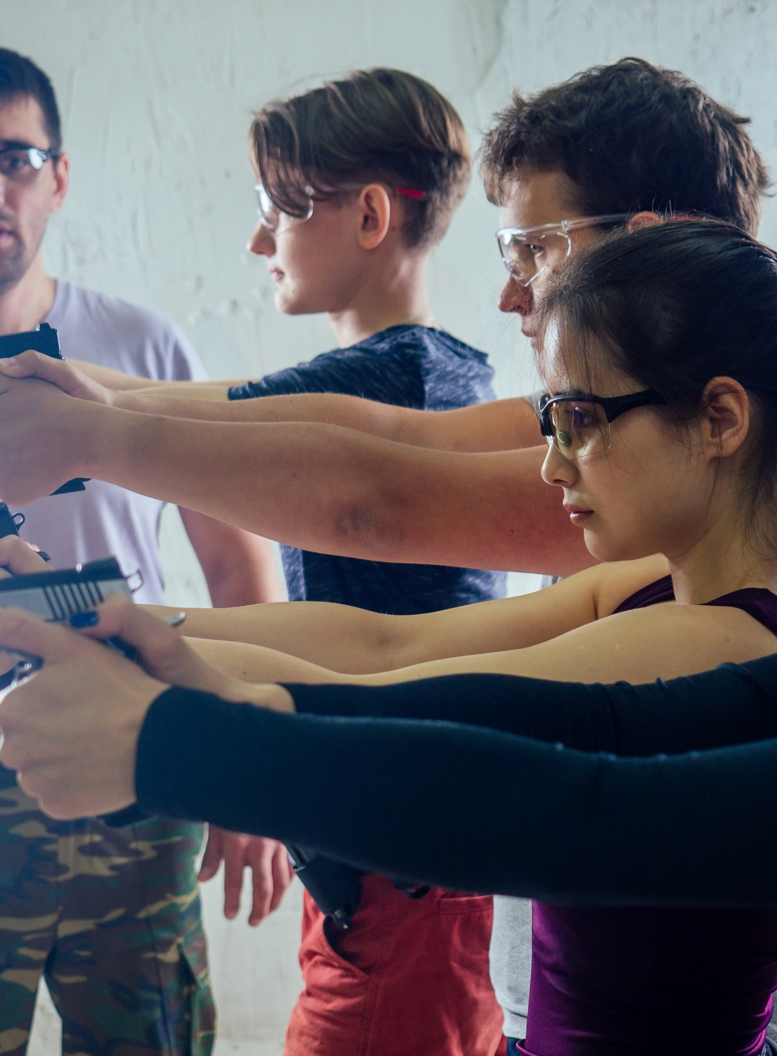
HANDLE FIREARMS SAFELY
RANGE SAFETY
  Know and follow all the rules of the Shooting Range.
  Listen and do what the Range Master tells you to do.
  Uncase and case your firearm at the shooting bench, never behind the safety line.
  Always keep the barrel pointed down range.
  Always keep the firearm on safe until you intend to shoot.
  Always wear eye and ear protection when shooting.
  Never shoot at water or hard surfaces.
  Apply Range Safety procedures even when shooting off-range.
Click here to return to the
SUMMER SAFETY MENU
36

Slide 37
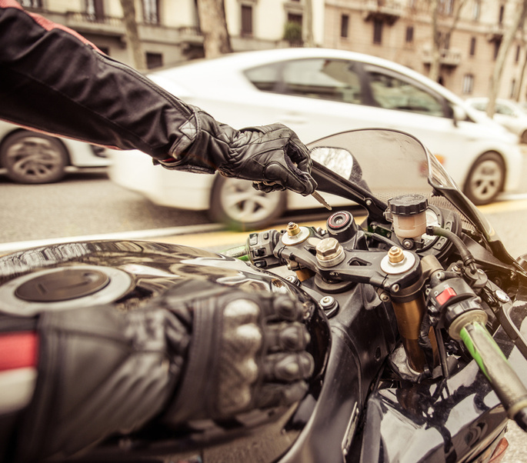
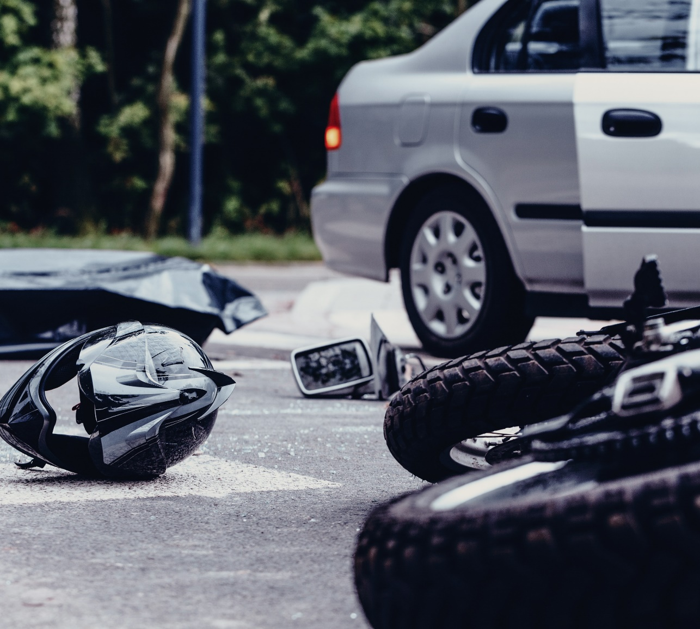
DRIVING SAFETY
In 2023 during the Summer season, the Department of the Air Force lost 15 Airmen and Guardians as a result of four-wheeled motor vehicle and motorcycle mishaps.
Click here to return to the
SUMMER SAFETY MENU
37

Slide 38
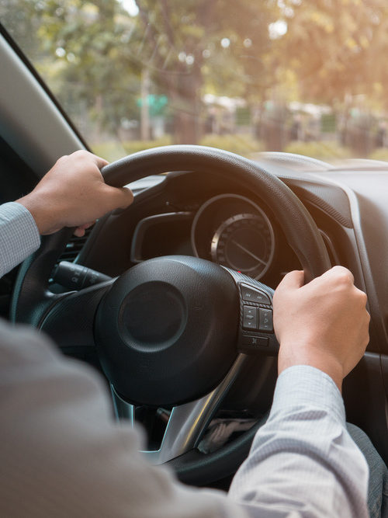
SAFE DRIVING
DRIVING SAFELY SHOULD ALWAYS BE YOUR TOP PRIORITY
When you’re behind the wheel of a car – whether alone or with passengers – driving safely is paramount.
We’re more distracted than ever, so it’s crucial to know the basics of safe driving and practice them every time you’re on the road. Ensure you and your vehicle are in the right condition before you get behind the wheel. Dangerous driving behaviors like speeding, distraction and impairment are the greatest threats to pedestrians.
  Don't drink and drive.*
  Avoid distracted driving.
  Follow the rules of the road and don't speed.*
  Use caution when changing lanes. Cutting in front of someone, changing lanes too fast or not using your signals may cause an accident or upset other drivers.
*Note: The Department of the Air Force data indicates that excessive speed, and alcohol were primary factors for four-wheeled motor vehicle and motorcycle mishaps.
Click here to return to the
SUMMER SAFETY MENU
38

Slide 39
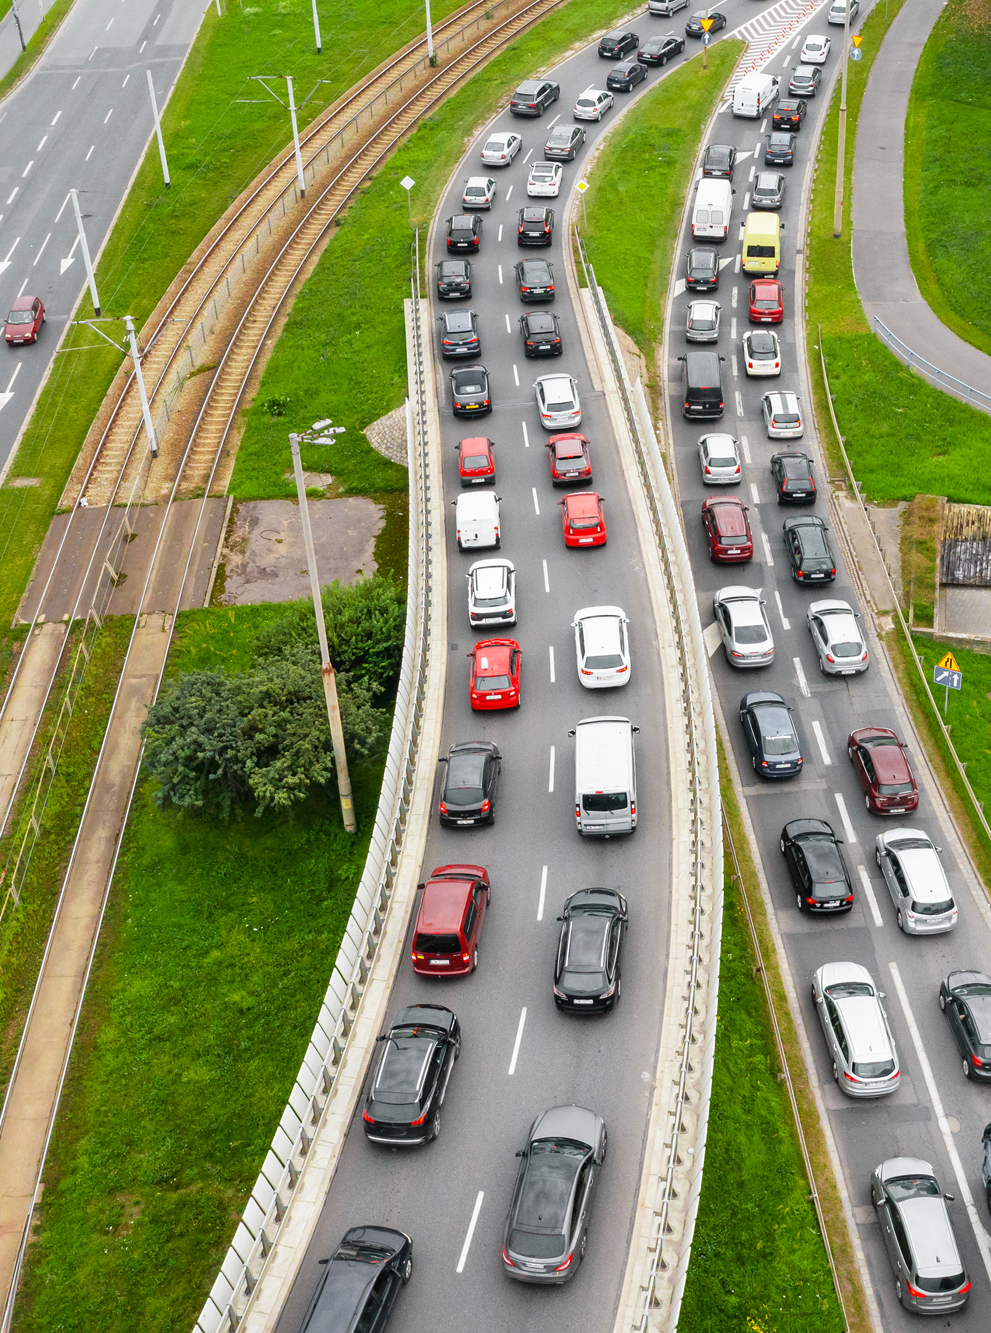

DRIVING FATALITIES
NATIONAL DATA
The National Highway Traffic Safety Administration projects that an estimated 40,990 people died in motor vehicle traffic crashes last year, a decrease of about 3.6 percent as compared to 42,514 fatalities reported to have occurred in 2022.
NHTSA’s analysis shows that the main behaviors that drove this increase include: impaired driving, speeding and failure to wear a seat belt.
Slow down.
Keep plenty of distance between you and the car in front.
Never drink and drive.
Always wear a seat belt.
Click here to return to the
SUMMER SAFETY MENU
39

Slide 40
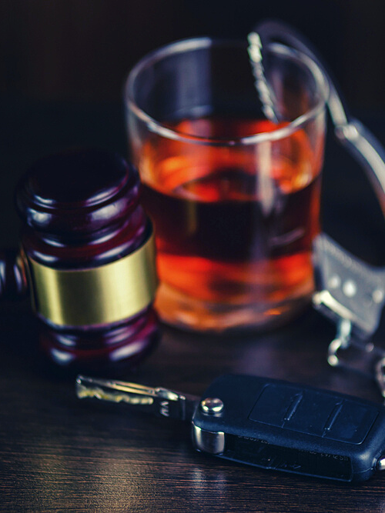
DRINKING AND DRIVING
IF YOU ARE DRINKING, DO NOT DRIVE
  Plan your safe ride home before you start the party, choose a non-drinking friend as a designated driver.
  If someone you know has been drinking, do not let that person get behind the wheel. Take their keys and help them arrange a sober ride home.
  If you drink, do not drive for any reason. Call a taxi, a ride-hailing service or a sober friend.
  If you’re hosting a party where alcohol will be served, make sure all guests leave with a sober driver.
  Always wear your seat belt — it’s your best defense against impaired drivers.
  Every day, 32 people die in drunk-driving crashes – that's one person every 45 minutes. That means you, your family or friends could be innocent victims. (Source: National Highway Transportation Safety Administration (NHTSA))
  All 50 states, the District of Columbia, and Puerto Rico have by law set a threshold making it illegal to drive with a BAC of .08 g/dL or higher.
  According to National Safety Council, 13,524 people died in alcohol-impaired crashes in 2022. Alcohol-impaired crash fatalities accounted for 32% of all crash fatalities in the U.S.
Click here to return to the
SUMMER SAFETY MENU
40

Slide 41
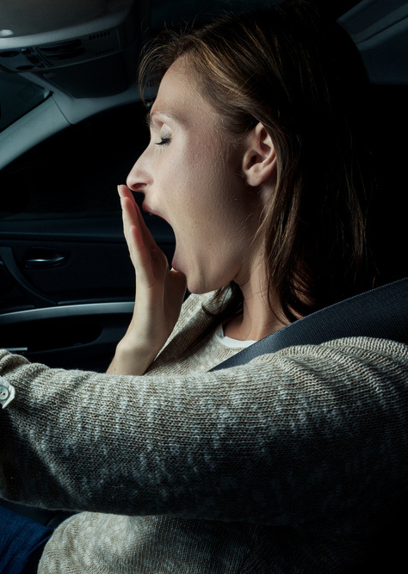
DROWSY DRIVING
WHO IS MOST AT RISK
  Sleep-deprived.
  Driving long distances after working a full shift.
  Driving through the night, the early afternoon or at other times when normally asleep.
  Drinking alcohol or taking medication that increases drowsiness.
  Driving alone for long distances without rest breaks or much change in scenery.
  Drowsing driving occurs most frequently between midnight and 6 a.m., says NHTSA.
KNOW THE SIGNS OF DROWSY DRIVING:
  Can’t remember the last few miles driven.
  Drifting from lane or hitting a rumble strip.
  Yawning repeatedly.
  Difficulty focusing or keeping eyes open.
  Tailgating or missing traffic signs.
  Trouble keeping head up.
Click here to return to the
SUMMER SAFETY MENU
41

Slide 42
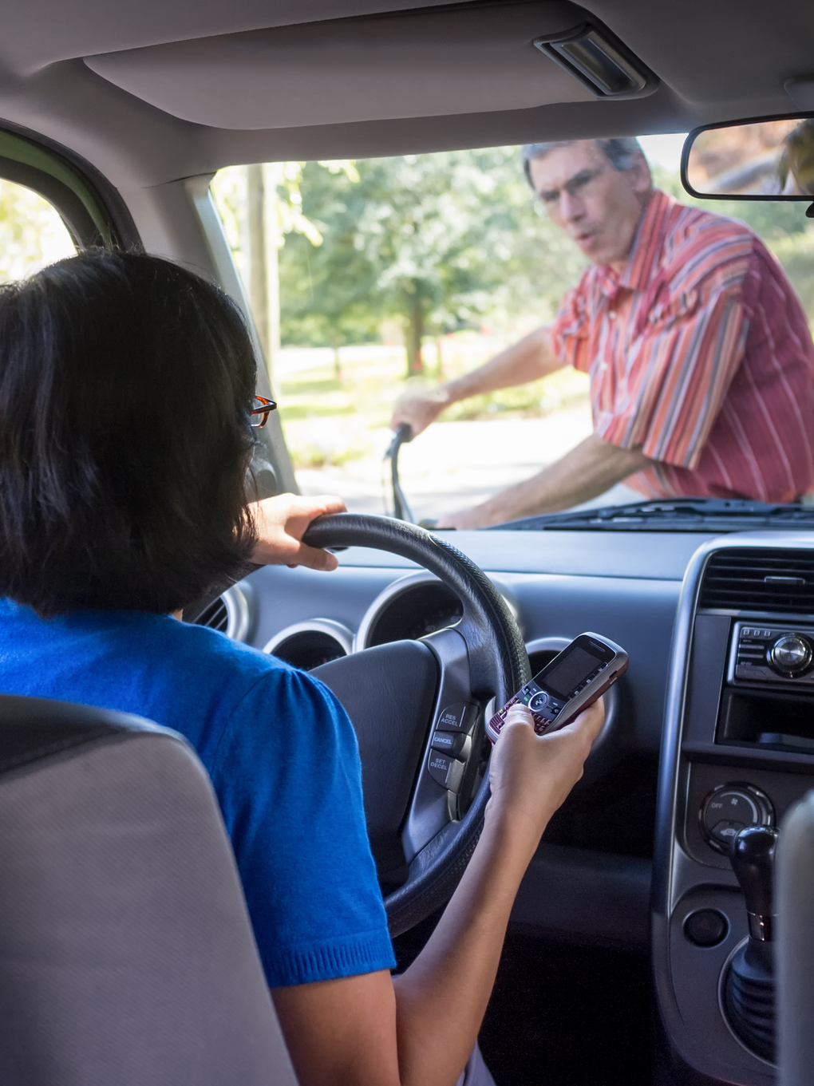
DISTRACTED DRIVING
THOUSANDS DIE IN CRASHES INVOLVING CELL PHONE USE
We’re more distracted than ever, so it’s crucial to know the basics of safe driving and practice them every time you’re on the road.
At any given daylight moment across America, approximately 660,000 drivers are using cell phones or manipulating electronic devices while driving, according to NHTSA. Using a cell phone while driving creates enormous potential for deaths and injuries on U.S. roads. In 2022, 3,308 people were killed in motor vehicle crashes involving distracted drivers. This is a decrease of about 6% from 3,521 deaths in 2021.
Don't allow children to fight or climb around in your car – they should be buckled in their seats at all times. Too much noise can easily distract you from focusing on the road.
You're not multi-tasking, you're distracted.
Click here to return to the
SUMMER SAFETY MENU
42

Slide 43
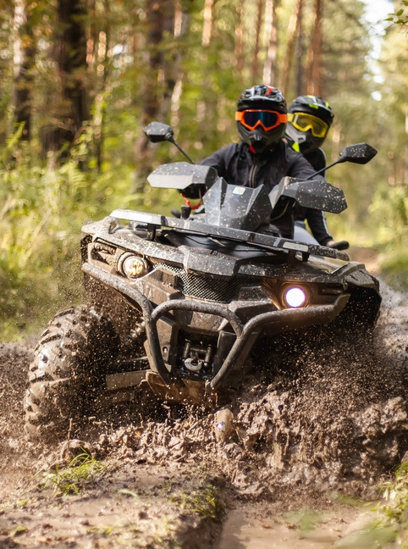
ATV AND UTV SAFETY
ATVs AND UTVs ARE NOT TOYS, GET TRAINING
There are about 700 deaths and 100,000 injuries every year involving OHV’s, according to Consumer Product Safety Commission.
  Read the owner`s manual carefully, and ensure the ATV or UTV is in good, working condition.
  Always wear an approved helmet.
  Never drive an ATV while under the influence of drugs or alcohol.
  Never drive an ATV on paved roads. Never operate ATVs or UTVs on streets, highways or paved roads, except to cross at safe, designated areas. Understand the terrain BEFORE you ride.
  Familiarize yourself with the local laws.
  Never ride alone, and always tell someone where you are going and when you will return.
  Always supervise young operators. Never carry extra riders.
Remember ATGATT: “All the Gear, all the Time!”
Click here to return to the
SUMMER SAFETY MENU
43

Slide 44
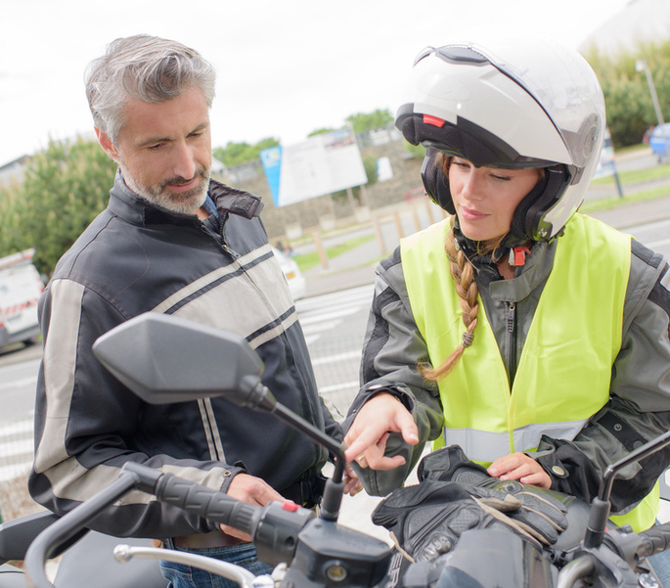
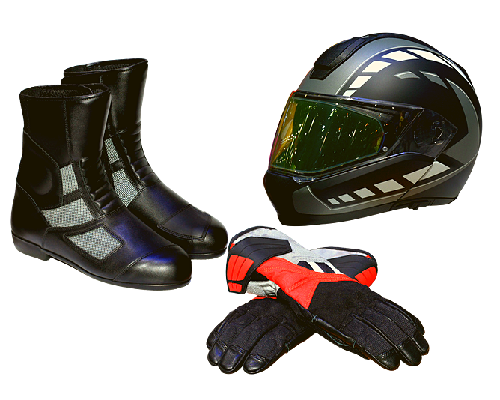
MOTORCYCLE SAFETY
In 2023 the Department of the Air Force
lost 22 Airmen and Guardians as a result of motorcycle mishaps.
Click here to return to the
SUMMER SAFETY MENU
44

Slide 45

MOTORCYCLE RIDING SAFETY
SEEING IS THE BEST WAY TO AVOID DANGEROUS SITUATIONS
SEARCH around you for potential hazards.
EVALUATE any possible hazards such as turning hazard.
EXECUTE the proper action to avoid the hazard.
A sound street strategy can help prevent a dangerous situation.
Training Requirements:
All Airmen and Guardians must have a permit or endorsement to complete LEVEL I training. Complete a DoD approved course within 6 months not to exceed one year of LEVEL I.
All Airmen and Guardians must complete a DoD approved refresher training every five years.
Take riding courses periodically to improve riding techniques and sharpen your street-riding strategies.
RIGHT TRAINING … RIGHT TIME … RIGHT BIKE
Click here to return to the
SUMMER SAFETY MENU
45

Slide 46

MOTORCYCLE SAFETY TIPS
MAKE MOTORCYCLE RIDING SAFETY YOUR TOP PRIORITY
  Complete a formal riding education program, get licensed and take riding courses periodically to improve riding techniques and sharpen your street-riding strategies.
  Obey the speed limit; the faster you go the longer it will take you to stop. Know and follow local traffic laws and rules of the road.
  Don’t drink and ride!
  Make sure your bike is fit and ready to ride. Perform all recommended checks and inspections before you hit the road.
  Always wear a helmet with a face shield or protective eye wear. A motorcycle rider not wearing a helmet is five times more likely to sustain a critical head injury.
  Wear leather clothing, boots with nonskid soles, gloves and an airbag vest to protect your body from severe injuries in the event of an accident or skid. Attach reflective tape to your clothing to help other drivers to see you.
  Ride defensively. Nearly two-thirds of all motorcycle accidents occur from a driver violating a rider’s right of way. Ride with headlights on; stay out of a driver’s blind spot; signal well in advance of any change in direction and watch for turning vehicles.
  Fatigue and drowsiness impair your ability to react. Make sure you are well-rested when you hit the road.
Click here to return to the
SUMMER SAFETY MENU
46

Slide 47
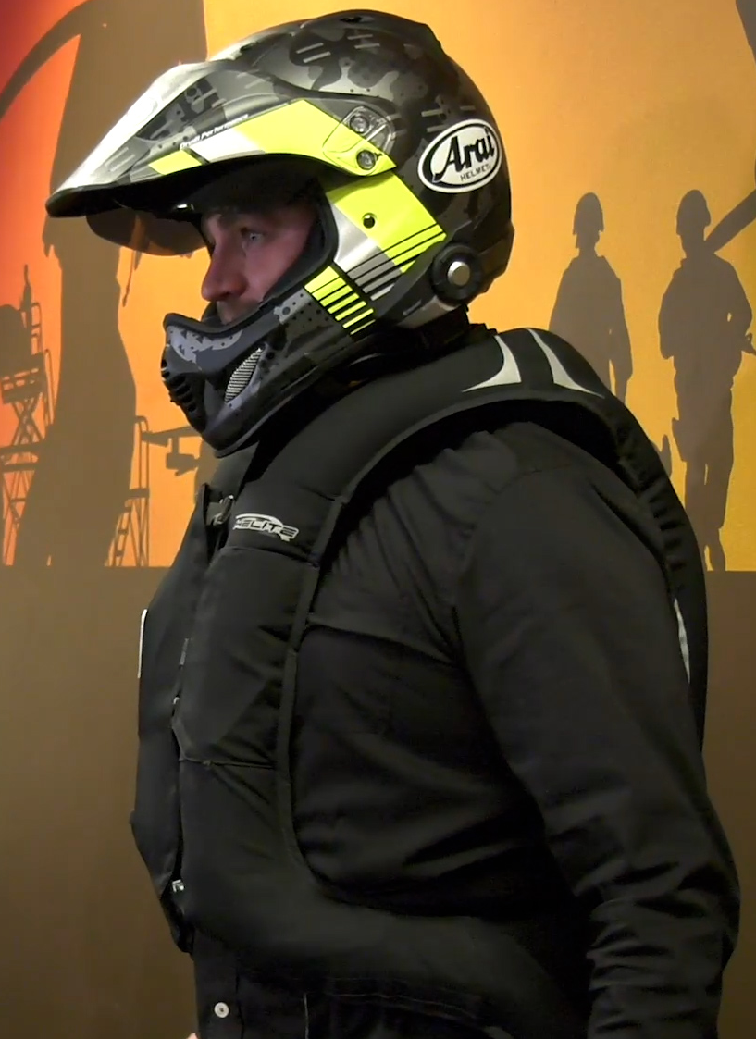
MOTORCYCLE PPE
WEAR PERSONAL PROTECTIVE EQUIPMENT (PPE)
Wearing Personal Protective Equipment (PPE) is your best defense when your skills are not enough to prevent an accident. In addition to a helmet, an airbag vest is one of the best – yet often overlooked – PPE you can purchase.
  Helmet - with a face shield or protective eye wear
  Airbag Vest
  Clothing - abrasion-resistant (leather or synthetic)
  Boots - with nonskid soles
  Gloves
Click here to return to the
SUMMER SAFETY MENU
47

Slide 48
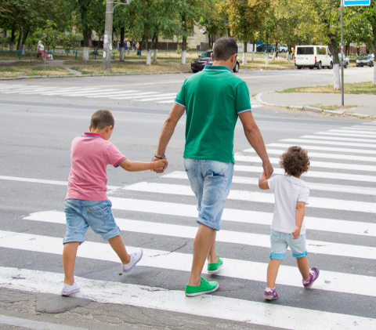

PEDESTRIAN SAFETY
In the past 10 years, during the summer season, the Department of the Air Force had 2 pedestrian-related fatalities.
Click here to return to the
SUMMER SAFETY MENU
48

Slide 49



PEDESTRIAN SAFETY
PEDESTRIANS AND DRIVERS SHARE THE RESPONSIBILITY
The Governors Highway Safety Association reported that an estimated 3,434 pedestrians were struck and killed in the first six months of 2022, up (5%) from the year before, or 168 more deaths. Dangerous driving behaviors were a major factor contributing to the trend.
We urge drivers to look out for pedestrians everywhere, at all times, to include those stopped on road shoulders with disabled vehicles.
  See and be seen.
  Use crosswalks and look left, right and then left again before crossing the street.
  Avoid distractions such as texting or watching videos on your phone while walking.
  Avoid walking when impaired by alcohol.
  Be visible at all times. Wear bright clothing during the day and wear reflective materials or use a flashlight at night.
  Use all your senses when near an area with moving vehicles.
  Never assume a driver sees you. Make eye contact with drivers as they approach to make sure you are seen.
  Walk on sidewalks. If no sidewalk, walk facing traffic and far from traffic as possible.
Click here to return to the
SUMMER SAFETY MENU
49

Slide 50


HOME SAFETY
In 2022, according to the National Safety Council, 178,400 people died from preventable injury-related deaths in the home.
Click here to return to the
SUMMER SAFETY MENU
50

Slide 51

SLIPS, TRIPS AND FALLS
ASSESS RISK AND USE THE RIGHT EQUIPMENT
More than 6.8 million people were treated in emergency rooms for fall-related injuries in 2020, according to the National Safety Council. Wet floors, slippery stairs and scattered toys all create the potential for falls.
  Stabilize staircases.
  Clear outdoor steps.
  Cover slippery surfaces in bathrooms.
  Install supports shower and bathtub.
  Secure toys, skateboards, bikes and other mobile toys in a safe area where family members and visitors won’t trip on them.
When working from a ladder assess risk and use right equipment.
  Make sure you have level ground and never lean it against an unstable surface.
  Ensure stepladders have a locking device to hold the front and back open.
  Always keep (3 points of contact) two hands and one foot, or two feet and one hand on the ladder.
  Wear slip-resistant shoes and don't stand higher than the third rung from the top.
  Don't lean or reach while on a ladder, and have someone support the bottom.
Click here to return to the
SUMMER SAFETY MENU
51

Slide 52

GRILLING SAFETY
SMELL THE FOOD GRILLING, NOT THE GRILL ON FIRE
According to the National Fire Protection Association, July (18%) is the peak month for grill fires including both structure, outdoor or unclassified fires, followed by June (15%), May (13%), and August (12%). Grill fires on residential properties result in an estimated average of 10 deaths, 160 injuries and $149 million in property loss each year.
  Use grill outside only, away from siding, deck rails and overhanging branches.
  Clean grills regularly to remove grease buildup.
  Never add charcoal starter fluid to fire.
  Never use gasoline or any flammable liquids other than starter fluid.
  Check the gas cylinder hose for leaks.
  Keep children and pets at least three feet away from the grill.
Click here to return to the
SUMMER SAFETY MENU
52

Slide 53

OPEN FIRE SAFETY
PREVENT BURN INJURIES
Many off-duty, outdoor fire burns sustained by Airmen and Guardians are caused by someone, either the service member or another person, pouring or shooting a flammable liquid into or near a fire; while burning yard debris; or by tripping and falling into the fire. Many incidents result in second-degree burns to the person’s face and torso.
  Do not pour, aim or shoot gasoline, alcohol, lighter fluid or any other flammable liquid into or near a fire.
  Keep the area around designated fire pits, campfires or bonfires free of trip hazards.
  Make sure fire pit is at least three feet away from structures and anything that can burn.
  Pay attention to where you’re walking and don’t run in the vicinity of an open fire.
  Keep a hose or water source nearby to extinguish the fire quickly if needed.
  Put out fires before you leave.
Click here to return to the
SUMMER SAFETY MENU
53

Slide 54

GARDENING SAFETY
GARDENING MAY SEEM SAFE, BUT HAS ITS HAZARDS
Emergency rooms treat more than 400,000 injuries each year related to outdoor garden tools, the U.S. Consumer Product Safety Commission says.
  Put away yard tools. Lawn tools, including rakes, saws and lawnmowers, can cause harm if not used and stored properly.
  Stay alert when using power tools, and never rush while mowing the lawn or using the weed whacker. Never leave tools lying around. Always keep them locked in a shed or garage where kids can’t access them.
  Wear safety gear whenever operating power equipment, including hedge trimmers (safety glasses, hearing protection, non-slip closed-toe shoes or boots, long pants or chaps, long sleeves and work gloves).
  Store poisoning chemicals safely. There were over two million poisoning incidents reported to poison control centers nationwide in 2020. Several household items present poisoning hazards, including gardening and home maintenance supplies.
  Wear gloves. Garden gloves will help protect you from blisters, fertilizers, pesticides, bacteria, fungi and sharp tools.
Click here to return to the
SUMMER SAFETY MENU
54

Slide 55

GARDENING SAFETY
CONTINUED
  Warm up. Just like an athlete does before a game, you should warm up before digging in the garden. Walk around your garden for a few minutes and do some pre-gardening stretches.
  Avoid repetitive motion. Prolonged and repetitive motions, such as digging, raking, trimming, pruning and planting, might irritate your skin, tendons or nerves. To avoid this, switch up your tasks every 15 minutes and take breaks between tasks.
  Banish bending. Kneeling instead of bending will put less strain on your back. For extra comfort, consider wearing kneepads.
  Check your lifting. When lifting objects, especially heavy ones, engage your legs and not your back. When you’re carrying heavy objects, hold objects close to your body to reduce strain.
  Look for pests. Check your clothes and body for ticks, which can cause several diseases. Better yet, help prevent tick bites by applying repellent.
  Block the sun and stay hydrated.
Click here to return to the
SUMMER SAFETY MENU
55

Slide 56

BLADED TOOL SAFETY
SHARP BLADES AND EDGES ARE POTENTIAL INJURIES
The most common concern when using sharp blades or edges is an injury, such as a cut (laceration, puncture) or an amputation. Tools or equipment with sharp blades or edges can include box cutters, utility knives, safety cutters and equipment with blades or moving parts such as hedge trimmers. To prevent cuts:
  Use the right tool for the job it was designed for.
  Make sure the blade is sharp. Dull blades require more force, increasing the chance of injury.
  Carry one tool at a time, tip and blade pointed down at your side.
  Work in a well lit space so you can see what you are doing.
  Cut on a stable surface.
  Use protective clothing such as cut resistant or mesh gloves, and safety glasses to protect eyes if the blade shatters or breaks.
  Cut away from your body. Make sure no body parts are in the cutting path, or in the path the blade might take if it slips.
  If the tool has a retractable blade, retract it immediately after use, and retract it fully. Similarly, close scissors or snips when not in use.
Click here to return to the
SUMMER SAFETY MENU
56

Slide 57

BLADED TOOL SAFETY
SAFE USE OF POWER TOOLS WITH SHARP BLADES
  Follow the manufacturer's instruction manual when you operate, clean, and maintain the equipment.
  Make sure that all guards and safety devices are in place and functioning properly.
  Make sure cutting blades are sharp.
  Keep your hands away from the edges of cutting blades – make sure you can see both your hands (and all your fingers) as well as the cutting blades. Keep your eyes on the item you are cutting and know where your fingers are in relation to the blade.
  Keep your hands away from all moving parts and avoid cleaning or brushing off moving parts such as cutting blades.
  Turn off and unplug the equipment before trying to dislodge items, and before disassembling and cleaning.
  Put all guards and safety devices back in place after cleaning.
  If there are moving parts, cover or tie back your hair, tuck in loose or frayed clothing and remove your gloves and jewelry.
  Do not bypass any guards or safety devices.
  Do not operate the equipment if you feel tired or unwell.
Click here to return to the
SUMMER SAFETY MENU
57

Slide 58
MISHAP REPORTING REMINDER
Off-duty mishaps
by uniformed service members
are required reports in the
AFSAS mishap reporting system: https://afsas.safety.af.mil
Without accurate data, honest analysis cannot be made.
Click here to return to the
SUMMER SAFETY MENU
58

Slide 59

CONCLUSION
UNDERSTAND INHERENT ENVIRONMENTAL RISKS
No matter where you are or what activity you're engaging in, make sure you know and understand the inherent environmental risks of that region, especially if you're new to or unfamiliar with the region. Threats vary depending on the locale.
Familiarize yourself with climate, local wildlife and any potential threats or dangerous situations specific to that activity and location. Make sure you've identified avenues for medical treatment (nearby hospitals) and always prepare for the unexpected.
Click here to return to the
SUMMER SAFETY MENU
59

Slide 60







www.safety.af.mil
AFSEC SHAREPOINT
@Air Force Safety Center
@AFSafety
@AirForceSafetyCenter
@Air Force Safety Center
AFSEC DVIDS
Click here to return to the
SUMMER SAFETY MENU
60

